Slide 1
Overview:
California State University &
University of California Systems
(CSU’s & UC’s)
Trivia: Which is the oldest CSU, and in which year was it built?

Slide 2
Overview of CSU’s and UC
What are the UC/CSU Systems?
What can I do now to be eligible?
What are the application deadlines?
What does it cost?
What does “impaction” mean?
What are the similarities?
What are the differences?
What resources are out there?
What questions do you have?

Slide 3
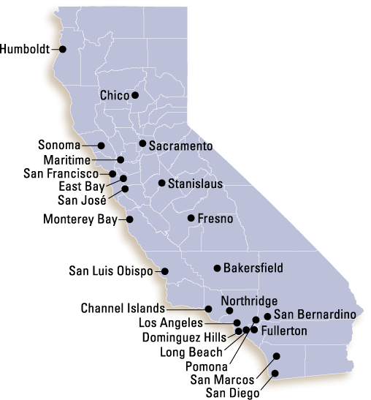
California Sate University (CSU’s)
23 Campuses
“4 Year” Programs and Post Bac.
  Bachelors of Arts and Science
  Masters Degrees
  Teaching Credentials
Requirements
  A-G Subject Req.
  GPA
  High School Graduate
First CSU…. San Jose State! Built in 1857 Go Spartans!

Slide 4

Eligibility Criteria for CSU’s
Eligibility
  A – G coursework (15 units)
  GPA: Grades in A-G courses (C or better!)
  High School Graduation
2.5 GPA (different in local context)
Impacted majors may exist on some campuses
ACT/SAT test to determine placement (no longer used for admissions)

Slide 5
Knowing the A-G’s
To be eligible for UC’s and CSU’s you NEED a C or better in these classes:
Letter | Area | Years Required | Years Recommended
A | History/Social Sciences | 2 years
B | English | 4 years
C | Mathematics | 3 years | 4 years
D | Laboratory Sciences | 2 years | 3 years
E | Language Other Than English | 2 years | 3 years
F | Visual and Performing Arts | 1 year
G | College-Preparatory Electives | 1 year

Slide 6

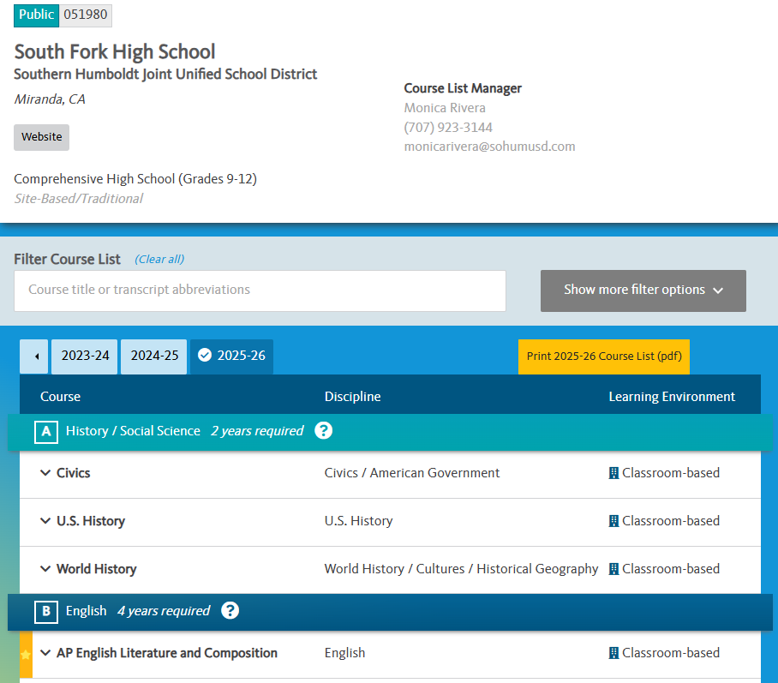
Knowing the A-G’s cont.
Find out your school specific A-G requirements:
https://hs-articulation.ucop.edu/agcourselist

Slide 7

CSU Application Process
www.calstateapply.edu
Oct. 1st – Dec. 1st
Take ACT/SAT by
December of your
Senior year (placement)

Slide 8

Average Cost of Attendance
On Campus:
  $25,500 (ish)
Off Campus
  $32,700 (ish)
With Parents
  $23,100 (ish)
Tuition: $7,600 (ish)

Slide 9
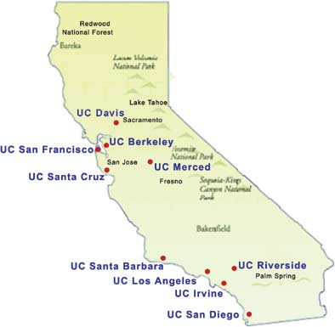
University of California
(UC’s)
10 Campuses
  9 for Undergraduates
“4 Year” Programs & Post Bac.
  Bachelors of Arts & Science
  Masters Degrees
  Doctorate Degrees
Requirements
  A-G Subject Requirements
  GPA
  Graduation

Slide 10

Eligibility Criteria for UC’s
Eligibility
  A – G coursework (15 units total)
  11 of them complete before the 12th grade.
  High School Graduation
  3.0 minimum weighted GPA (no grade lower than C)
Impacted campuses/majors may require SAT Subject tests
Top 9% in your class = guaranteed admission (UC’s overall if min. req. met)
Holistic Review
SAT/ACT – may be used as alt. method of fulfilling min. requirements or course placement
Notes:
GQ: look into holistic review – top 9% in class

Slide 11
UC Application Process
www.universityofcalifornia.edu
Aug. 1st (prep period)
OCT. 1 – DEC. 1st (filing period)
Compose Personal Insight Questions

Slide 12
Personal Insight Questions (PIQ’s)
You will have 8 questions to choose from. You must respond to only 4 of the 8 question
Each response is limited to a maximum of 350 words.
Which questions you choose to answer is entirely up to you:
But you should select questions that are most relevant to your experience and that best reflect your individual circumstances

Slide 13
3 examples (out of 8)
Describe an example of your leadership experience in which you have positively influenced others, helped resolve disputes or contributed to group efforts over time.
Describe how you have taken advantage of a significant educational opportunity or worked to overcome an educational barrier you have faced.
What have you done to make your school or your community a better place?
Notes:
Translate these insight questions

Slide 14
Holistic Review:
13 Factors
Beyond grades and test scores
Academic GPA
Courses beyond A – G
Honors/AP/IBO
Top 9% of HS class, end of junior year
Senior Year Classes
Doing all you can with what is offered
Outstanding in a subject
Outstanding projects
Marked academic improvement
Special talents/achievements
Special Projects tied w/curriculum
Accomplishments in light of tougher circumstances
Location of your school/home

Slide 15
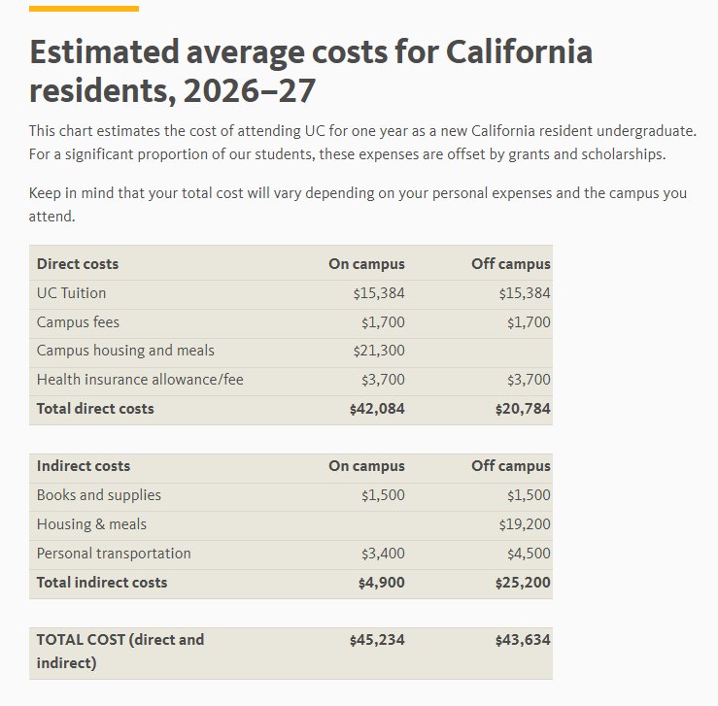
Average Cost of Attendance
On Campus:
  $45,300 (ish)
Off Campus:
  $43,700 (ish)
TUITION & Fees: $20,784
Fun Fact: “54% of UC’s California undergrads pay no tuition” https://admission.universityofcalifornia.edu/tuition-financial-aid/

Slide 16
Impaction (both CSU’s and UC’s)
Impaction means that a campus receives more eligible applicants then they can accommodate and therefore must restrict enrollment to that campus (often requiring higher eligibility standards)
Impacted Campuses
Impacted Majors and Programs
Impacted Groups: (Freshman, Transfers)

Slide 17
Similarities
Public Institutions
A – G Rigorous Curriculum
  GPA after 9th Grade
ACT or SAT exams for placement
Offers Bachelors, Masters, and Professional Degrees
Have impacted/closed majors at some campuses
Only have to fill out one application for all 23 CSU’s or 10 UC’s. (Fee’s apply to each)

Slide 18

Differences
The Application Process
The Cost of Attendance
Holistic Review (UC)

Slide 19
List of Resources
www.assist.org (A – G)
www.calstateapply.edu (Apply)
www.universityofcalifornia.edu
(Apply)
www.fafsa.gov (Free Money)
www.actstudent.org (ACT)
www.collegeboard.org (SAT)

Slide 20
Ask Yourself…
Am I on the A – G college prep track?
Whose responsibility is it to make sure I am?
What if I have a “D” grade on my transcript in an
A – G course?
Who can I go to for guidance and assistance?

Slide 21

WHERE CAN YOU GO?
  High School Counselor
  AVID/TRiO/CalSOAP
  High School Teachers
  The colleges in your area
  The internets, specific campus website
  Me! (Gema) 707-826-3576
  AND……..

Slide 22
ONE MORE COOL WEBSITE!!!
www.californiacolleges.edu
  Career Planning
    Explore Careers and Job Outlooks
  High School Planning
    Planning timeline, How to succeed in High School
  College Planning
    Explore Schools, Programs, Majors, and test prep
  Financial Aid Planning
    Scholarships, Grants, etc…
  Your Portfolio
    Tools and Resources appropriate to YOU.

Slide 23
Questions?
Cal Poly Humboldt TRiO Upward Bound
Gema Quiroz-Torres
gema@humboldt.edu
North Coast Cal-SOAP
(707) 441-2006
https://hcoe.org/college-expo/

