Slide 1


Slide 2
College of the Redwoods is
YOUR Community College
http://youtu.be/0iXyLQE4n9g

Slide 3


Slide 4
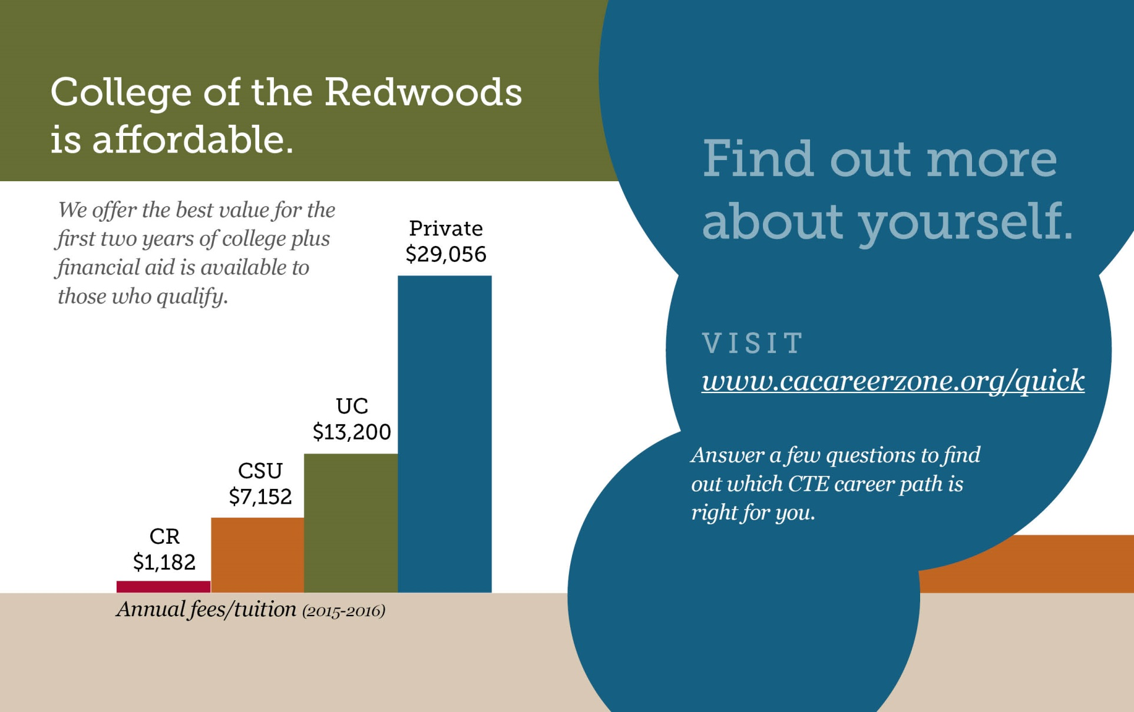

Slide 5
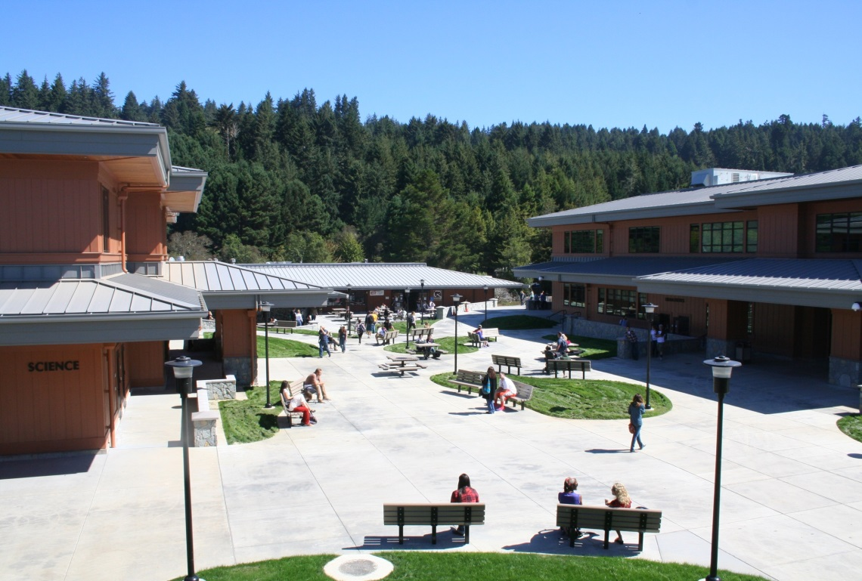
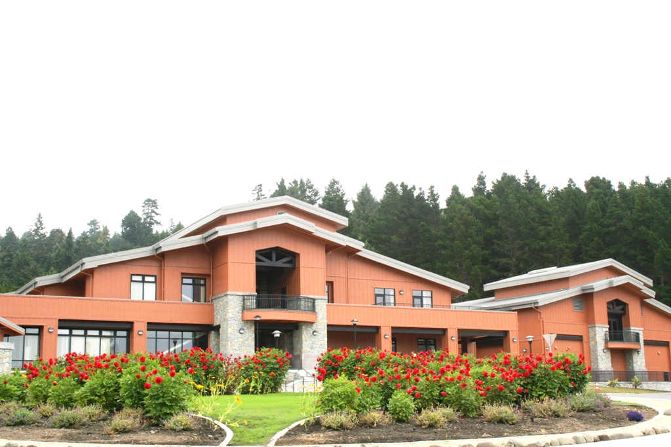
Notes:
CR has so many things to offer to help students have a successful and enjoyable educational experience:
CR is accredited and has financial aid and scholarship opportunities: last year the foundation awarded over $100,000 in scholarships to CR students!
CR offers transfer paths to higher education and a variety of degrees and courses for career advancement and personal enrichment.
9,000 students every year, Around 5,000 on main Eureka campus, and our online course offerings are growing.
One of only 11 campuses that have on-campus housing.
Has a sports programs, student senate, campus clubs, and a diverse student body.
New facilities were finished this year, made possible by Measure Q and state bonds. They contain smart boards and advanced technology in the classroom, comfortable seating and environment, and the architecture is beautiful and features repurposed redwood.
Of course, those are just side perks, right ;)
In terms of the specific academic programs, CR offers:

Slide 6

Degree, Certificate and Transfer Options
Notes:
Degree, Cert and Transfer Options

Slide 7
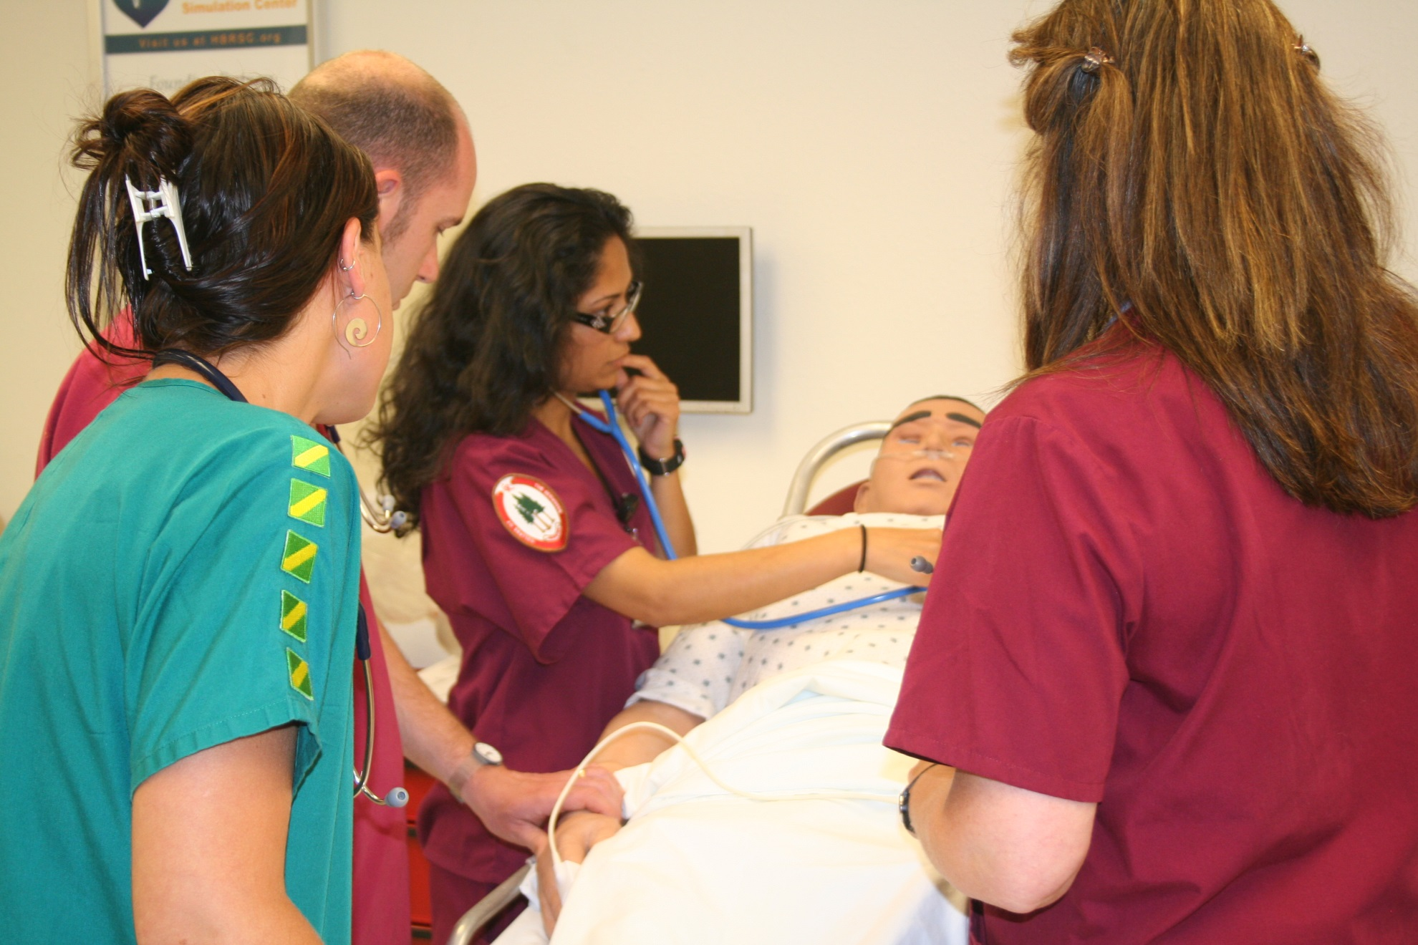

Slide 8


Slide 9
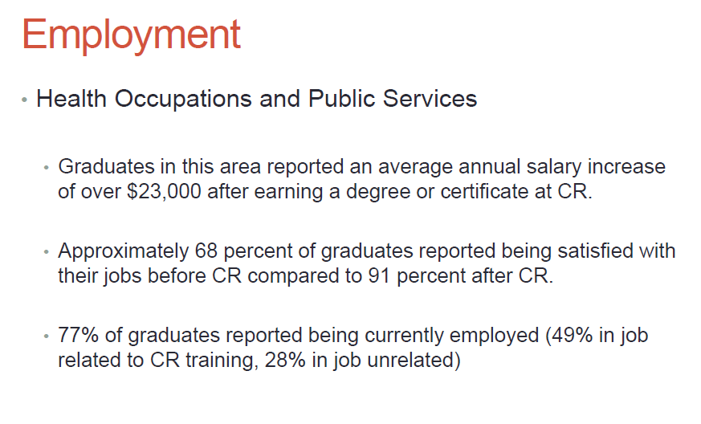
CR Institutional Research, 2013
Notes:
Similarly, in health occupations and public services,

Slide 10
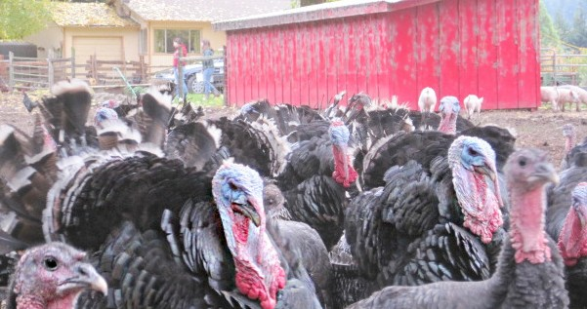
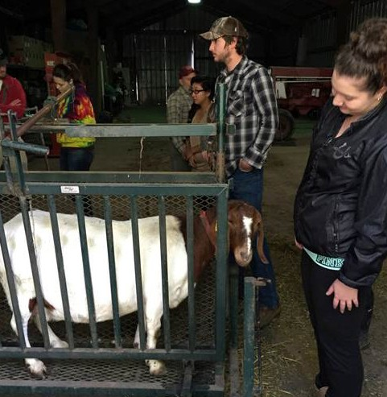
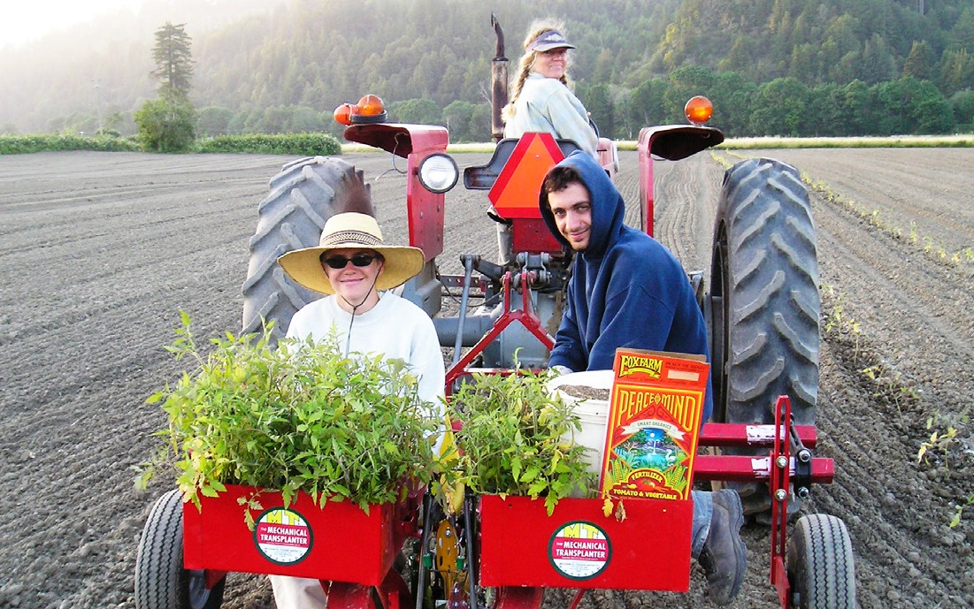
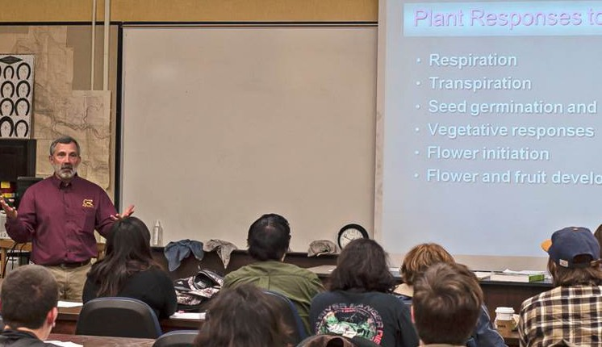
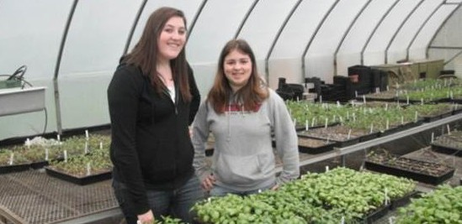
Career Technical + Transfer
Agriculture
The College of the Redwoods Agriculture program is designed to train students in progressive agricul- tural practices in the areas of Plant Science, Animal Science and Agriculture Business Management.
The program caters to students looking to earn an Associate Degree and those who wish to transfer to a four-year university. Students will be able to complete their degree in four semesters.
Students engage in a multitude of hands-on, production-oriented activities in the classroom and on our 63-acre farm lab. This is an integral part of the rigorous curriculum and degrees, which transfer to four year universities in California.
Students in the agriculture program at CR have the opportunity to mentor high school seniors through the AG Leadership class. The AG Leaders participate in field trips including leadership confer- ences, livestock judging and other career develop- ment events. These student leaders work with the community to promote agriculture awareness.
CR Faculty work closely with the local agricul- tural community to ensure that the program’s focus is current, progressive and meets industry standards.
Graduates of the Agriculture program will be able to:
Did You Know . . .
Agriculture is the world’s largest economic sector.
On a worldwide basis, more people are involved in agriculture than in all other occupations combined.
Agriculture and agricultural science touch every aspect of American society from the individual consumer’s health and safety to the nation’s welfare, security, and environmental sustainability.
Agricultural research is fueling innovation in many parts of the economy not generally associ- ated with agriculture, such as energy, electronics, plastics, and pharmaceuticals.
Describe the economic significance of California Agriculture and its relationship to the global economy.
Utilize a variety of technologies to gain information about the Agriculture industry and apply these tech- nologies in the analysis of specific situations.
Demonstrate good work habits and interpersonal communication skills that employers demand.
Apply sustainable/organic agricultural production techniques to specific crops.
Careers in Agriculture
Agriculture Sales and Service Nursery/Greenhouse Manager Farm Equipment Operator
Entry Level Livestock/Food/Fiber Industry Positions Farm/Ranch Owner Operator
Pathways in Agriculture
College of the Redwoods offers an Agriculture program that gives students an opportunity to transfer to a 4-year university and an option to complete a degree:
Students engage in a multitude of hands-on, production-oriented activities in the classroom and
on our 63-acre farm lab.
Associate of Science |Agriculture General Associate of Arts | Liberal Arts: Agriculture Certificate of Recognition | Agriculture Production

Slide 11


Slide 12
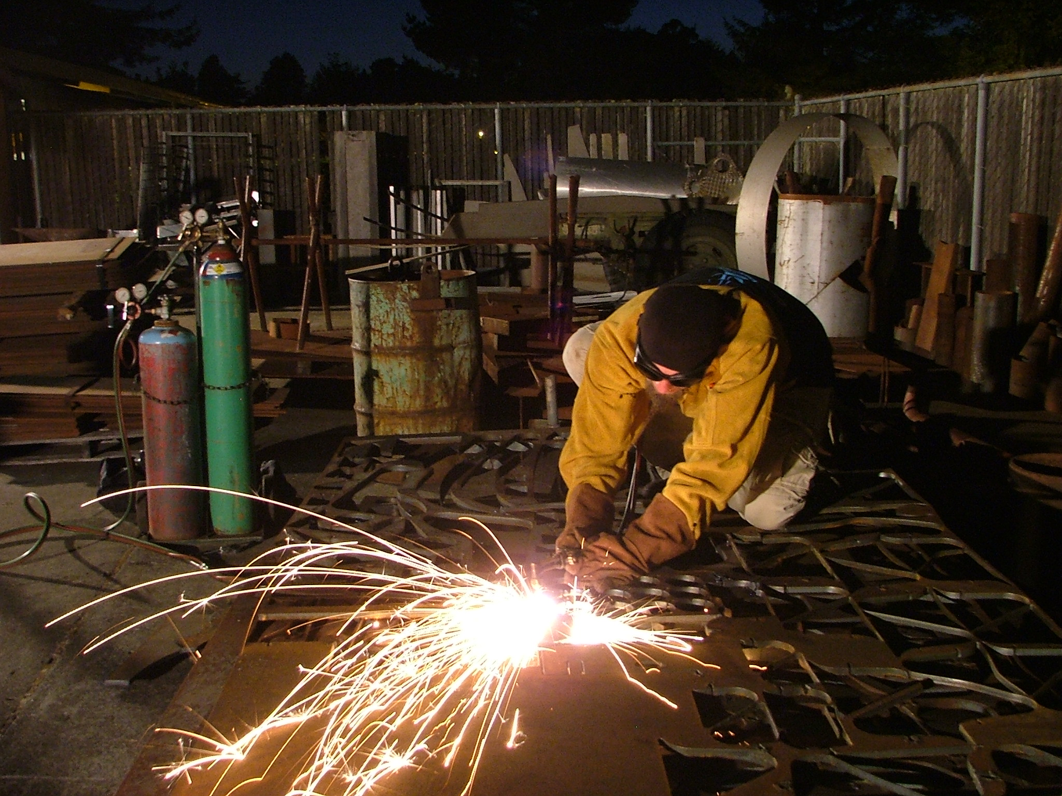

Slide 13
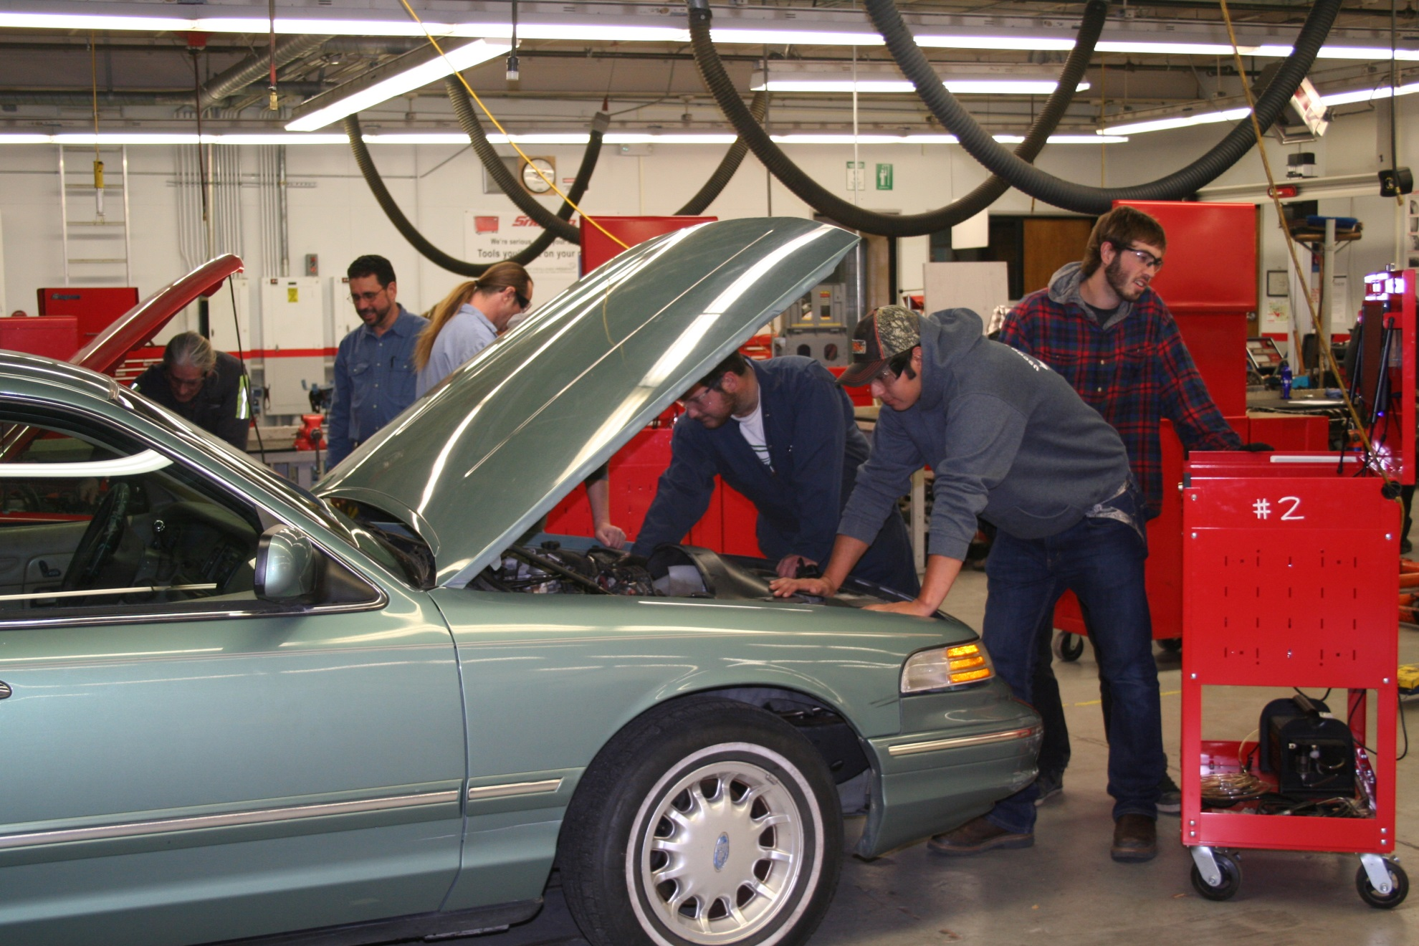

Slide 14
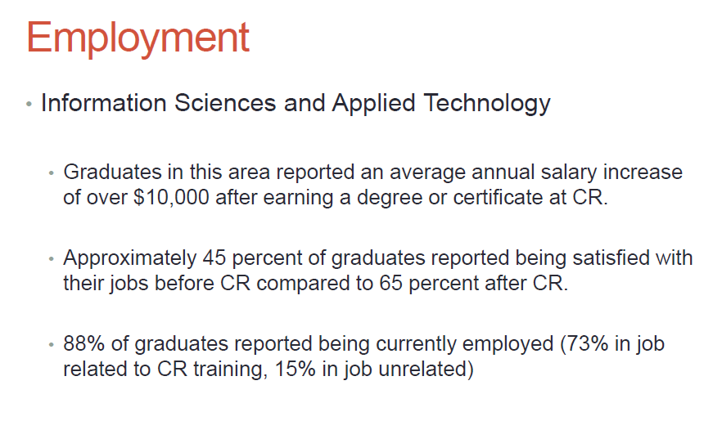
CR Institutional Research, 2013
Notes:
Surveys taken by institutional research reveal that in information science and applied technology:

Slide 15


Slide 16


Slide 17
Drafting Technology
Manufacturing Technology
Drafters and Designers in technical and 3D designs
Programmers
Model Makers
Machinists
Engineering Assistant
Learn skills to operate CNC machinery, CAD/CAM software, 3D printing design
ATMAE national certified programs !

Slide 18
Career Technical Education
Associate Degrees and Certificates Available
in other programs:
  Administration of Justice
  Addiction Studies
  Agriculture
  Restaurant & Hospitality Management
  Welding
  Drafting Technology
  Manufacturing Technology
  And many more!
Notes:
Career Technical Degrees & Certificates
Overall CR offers 39 Degrees, 31 Certificates of Completion, and 16 certificates of recognition. These are examples of some of the Career Technical programs designed to get students into the workforce in a short period of time. Administration of Justice – police academy, Business, Digital Media, Nursing, Dental Assisting, Computer Science, Construction, Drafting, Early Childhood Education, Forestry, Welding, and many more…

Slide 19


