Slide 1
Overview: California Community Colleges
How to get started at
College of the Redwoods!

Slide 2
Trivia Question!
How many Community Colleges are there in California?

Slide 3
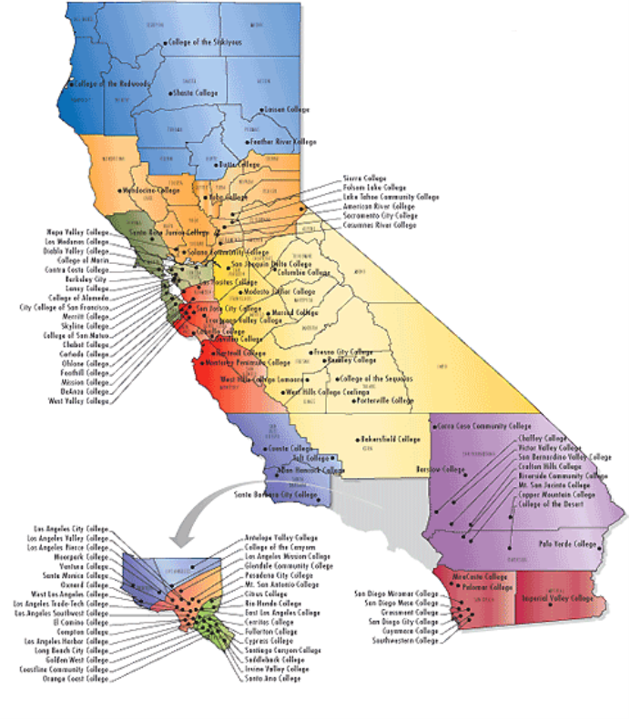
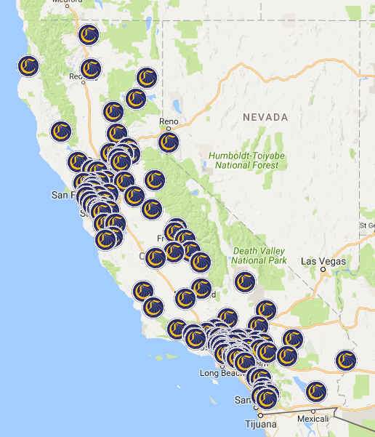
Answer: 116!!!!

Slide 4
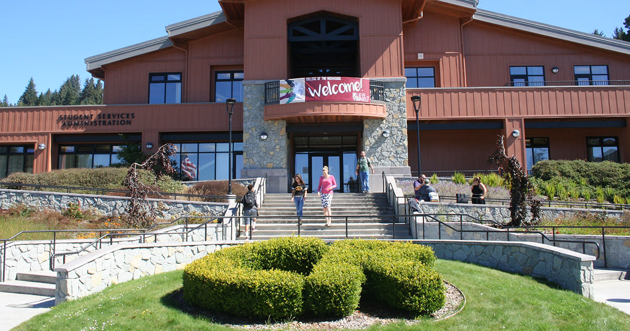
Getting Started at College of the Redwoods
What does Community College have to offer?
What is the application process?
What makes me eligible?
What does it cost?
Admissions Information & Resources
What questions do you have?

Slide 5
What does Community College have to offer?
Personal Growth
Professional Training
Certificate of Achievement/Recognition
Associate Degrees (AA or AS)
University Transfer
Associate Degrees for Transfer (AA-T or AA-S for CSU)
Transfer Admissions Guarantees (TAG – for UC, Transfer Success Pathway for CSU)
Degree with a Guarantee!
https://icangotocollege.com/associate-degree-for-transfer

Slide 6
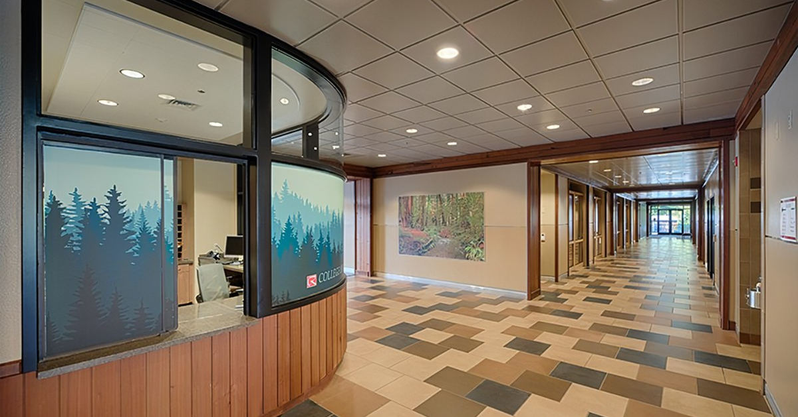
Certificate Programs at CR
Addiction Studies
Administration of Justice
Agriculture
Aquaculture
Automotive Technology
Business Administration
Computer Information Systems
Construction Technology
Early Childhood Education
Forestry & Natural Resources Technology
Graphic Design & Visual Communication
Health Occupations
Personal Trainer
Social Work & Human Services
Welding Technology

Slide 7
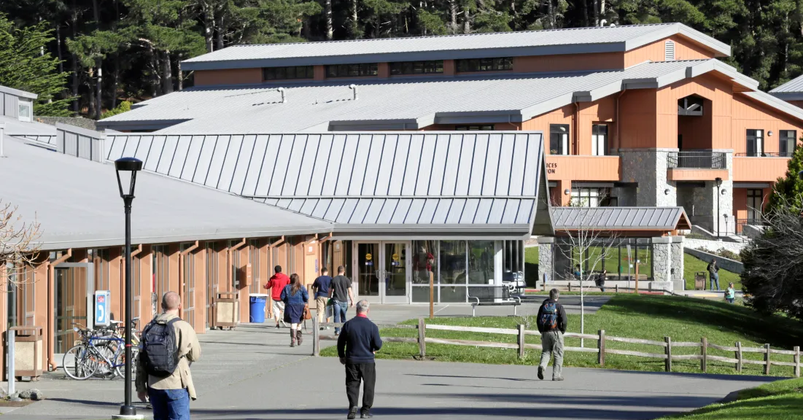
Associate Degrees
Associate of Art Degree (AA)
Examples: Arts, Humanities, and Social Sciences
Associate of Science Degree (AS)
Examples : Science, Technology, Engineering, Math
Associate Degree for Transfer (AA-T or AA-S)
Associate Degree designed to be fully transferrable to a CSU in a specific major of study.

Slide 8
Transfer Options
CCC Transfer Guarantees with Historically Black Colleges & Universities (HBCUs)
CCC Associate Degree for Transfer (CSU only)
Transfer Success Pathway (CSU only)
UC Transfer (TAG*)
Western Undergraduate Exchange (WUE) Transfer
Notes:
Transfer Admission Guarantee—Only for select campus. 6 campuses offers Davis, Irvine, Merced, Riverside, Santa Barbara & Santa Cruz

Slide 9
What makes me eligible?
You are 18 years of age or older, with or without a high school diploma
You are a high school graduate
You have the equivalent of a high school diploma
We also have options for students who are still in High School!

Slide 10
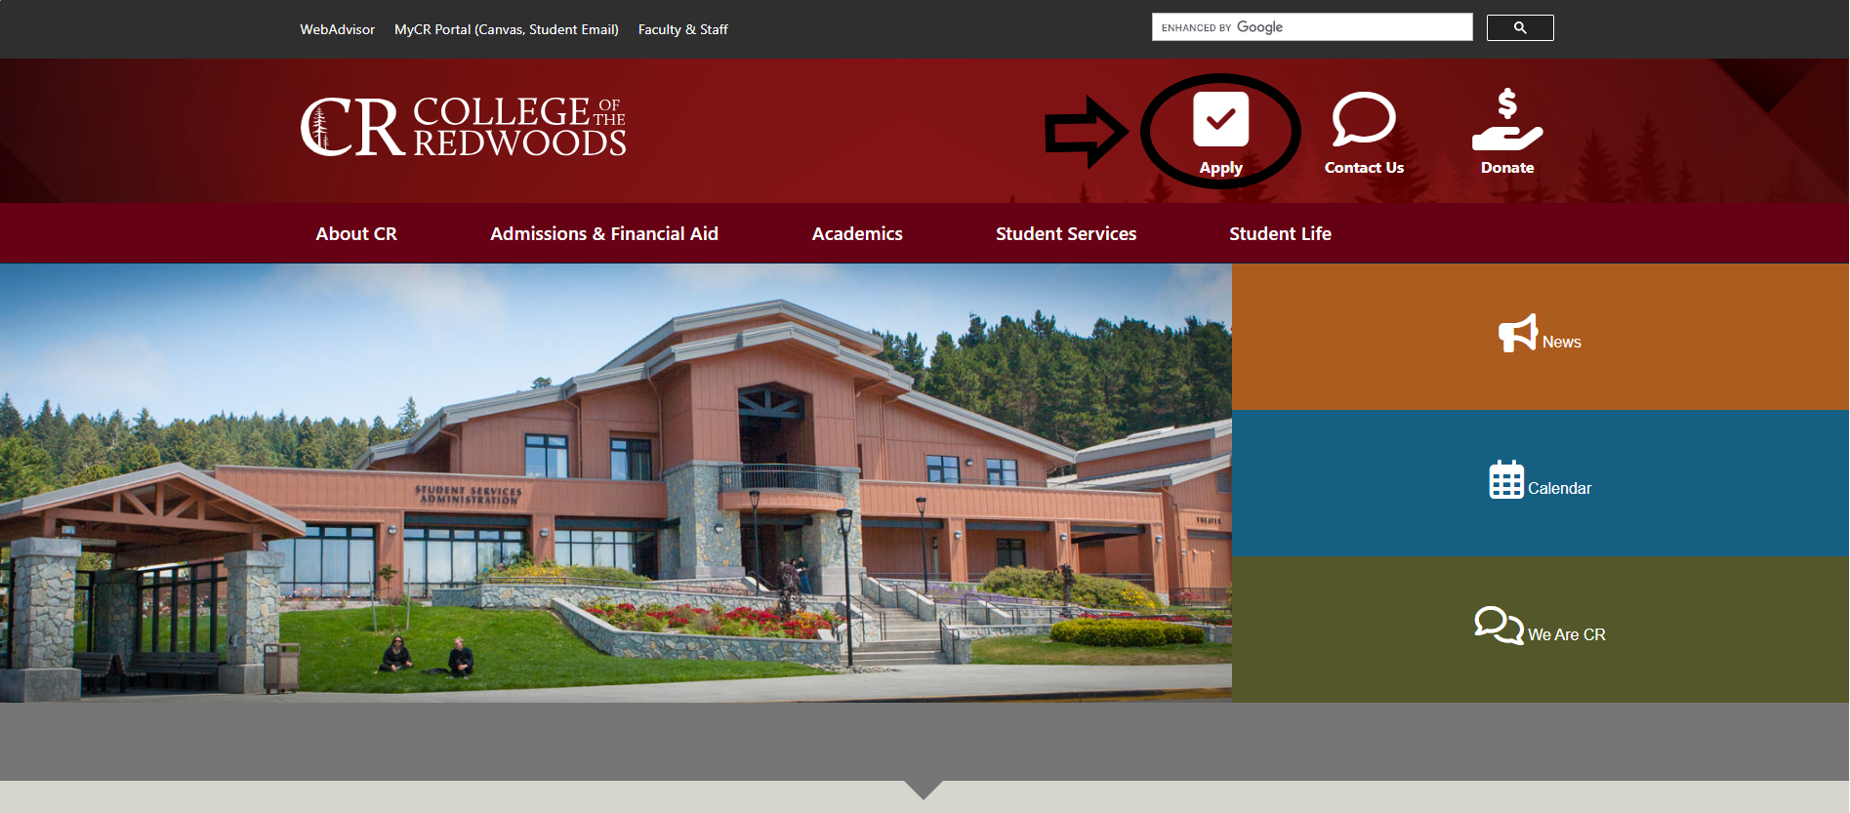
CR Application Process

Slide 11
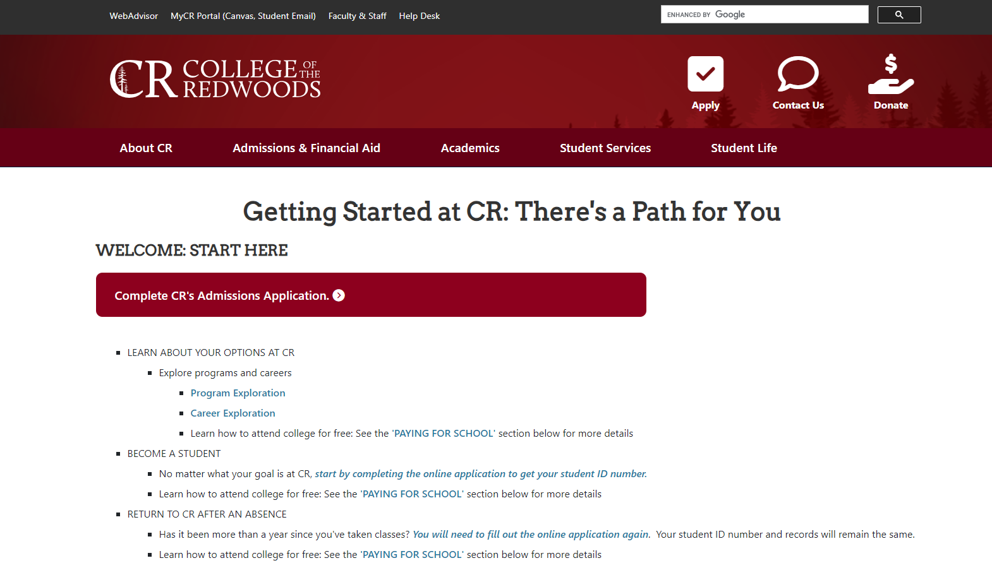

Slide 12
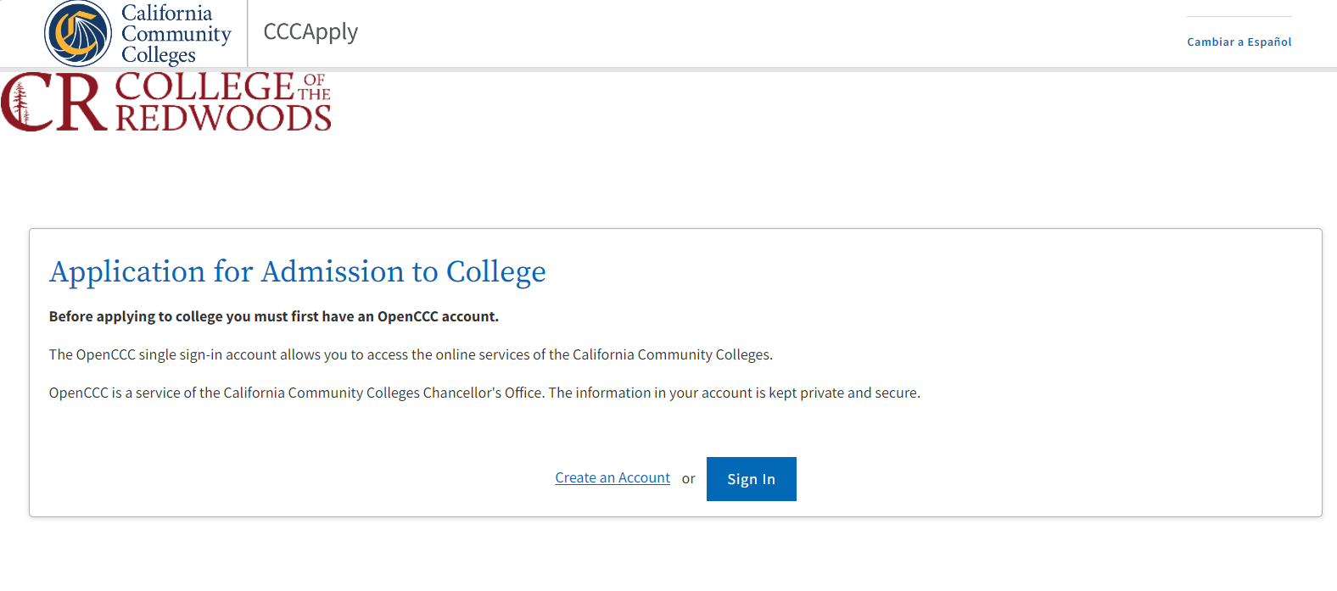

Slide 13
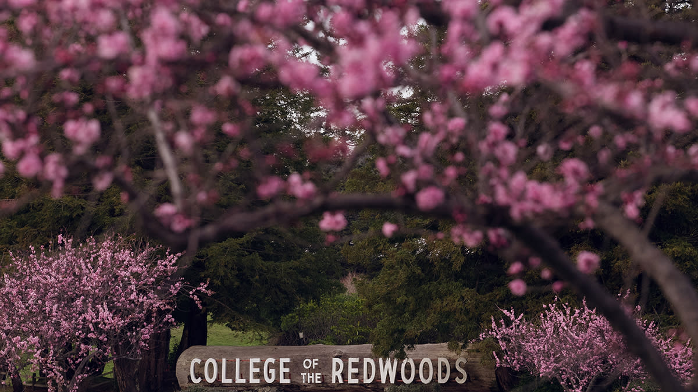
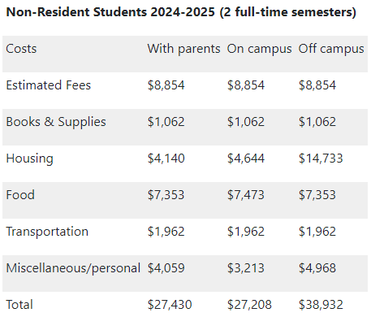
Estimated Costs of Attending CR

Slide 14
Ask Yourself
Where can I go for guidance and assistance
in the college and career application process?
High School Counselor
AVID/TRiO/CalSOAP
High School Teachers
The colleges in your area
The internets, college websites
Me! (Christina – 707-476-4301)
AND……..

Slide 15
ONE MORE HELPFUL WEBSITE!!!
www.californiacolleges.edu
Career Planning
Explore Careers and Job Outlooks
High School Planning
Planning timeline, How to succeed in High School
College Planning
Explore Schools, Programs, Majors, and test prep
Financial Aid Planning
Scholarships, Grants, etc…
Your Portfolio
Tools and Resources appropriate to YOU!

Slide 16
Get ready to start your journey!
CR Admissions & Records Contact info:
Phone: 707-476-4200
Email: admissions@redwoods.edu
Monday – Thursday 9am – 4pm
Friday 11am – 3pm
Student Services building on the Eureka campus.
Explore all that Community College has to offer,
we are here to help you succeed!

