Slide 1




A reason for being; the thing that gets you up in the morning.
Getting to College
Dream, Prepare, Go!
Notes:
Land acknowledgement: at HSU before we give a presentation or have an important conversation, we practice doing a land acknowledgement. It is meant to remind us to be respectful and gratitude to the (Wyott) indigenous people that continue to take care and protect the land we stand on.
An old term, but recently popularized by Japanese psychologist and professor, when he wanted to help people find their passion and how they can make a living off of it.
IKIGAI = your purpose, it is more than a hobby, it is finding what you would love to do everyday.

Slide 2
Supporting Youth to
DREAM, PREPARE, GO!
Jana Ashbrook
Academic Preparation for College
eap@ humboldt.edu
Gettingtocollege.Humboldt.edu
Getting to College
Dream, Prepare, Go!
Notes:
No matter what pathway you take, consider your year a bridge year.

Slide 3
A reason for being; the thing that gets you up in the morning.
Getting to College
Dream, Prepare, Go!
Notes:
Land acknowledgement: at HSU before we give a presentation or have an important conversation, we practice doing a land acknowledgement. It is meant to remind us to be respectful and gratitude to the (Wyott) indigenous people that continue to take care and protect the land we stand on.
An old term, but recently popularized by Japanese psychologist and professor, when he wanted to help people find their passion and how they can make a living off of it.
IKIGAI = your purpose, it is more than a hobby, it is finding what you would love to do everyday.

Slide 4


What I love
What I’m
good at
What the
world needs
What I can
be paid for
Getting to College
Dream, Prepare, Go!
Notes:
He created this diagram to help people form connections with these four questions. In the center is IKIGAI.
I want you right now to draw this diagram and answer the questions. It is okay if you can’t fill all of them, do what you can with bullet points, a long sentence or a very detailed passage, try to answer all four. When you see your four answers layed out what is important to notice is the overlapping and the way they connect with each other.
Just want to let you know your IKIGAI could change throughout your life but giving yourself this start keeps you focus and helps you form a path.

Slide 5

Prepare
What degrees would set me on my path?
What colleges are a good fit?
What do I need to do to get into my choice colleges?
What college choice is a good investment?
Is working during college a good idea?
Where should I live?
Getting to College
Dream, Prepare, Go!
Notes:
How many CSU are there?
What does your GPA need to be to get in?
I want to let you know that this number is the least amount you need to get in. Some departments offer much higher and you need to make sure you look into that.
What else do you need to have completed? A-G classes and SAT and/or ACT
What levels of degrees can you get from CSUs?
Personal story: I want to show you guys my first day in Humboldt, when my parents were dropping me off to college. We drove all the way from LA (12 hour drive). I really recommend that whichever college you go to, take a picture with their sign. Because years after you will look back and realize how much you accomplished. You can’t tell in the picture, but I was scared and nervous, it was the first time being on my own, but I was also excited because I picked a place that I felt I can study and grow in. I found comfort in choosing a university that matched my needs.
Ask LEO for more information

Slide 6




Degrees | (AA) Associates of Arts/Science Associates for Transfer Associates for transfer | Bachelor of Arts/Science Masters Degrees PhD & EcD | Bachelors of Arts/Science Master Degrees PhD & EdD | Bachelor of Arts/Science Masters Degrees PhD & EdD
Admissions Requirements | HS Diploma | A-G Classes, SAT or ACT, +2.0 | A-G Classes, SAT or ACT, +3.0 | Varies
Number of Campuses | 114 | 23 | 10 | 0ver 100
Getting to College
Dream, Prepare, Go!
Notes:
Just to recap these are the four systems of schooling. You can find this in any state. You will have your community colleges, state university, UCs and your private colleges.
My advice to you is that when you are thinking of choosing what school best suits you, ask yourself what type of learner are you? What is the environment that you tend to be your best at?
Each system offers a different student experience. For example, CSUs (offers small class size, more personal time with professors, very intertwine with the local community.) UCs (have bigger class size, professors rely on students to complete assignments, competitiveness is more present. What is great about UCs is that if you are someone that thrives on competition and prefer to receive assignments and just turn them in. UCs have that vibe.)
I would advice to think about what type of learner are you. For example: A school could have the program you want, but if you feel that the location, staff, and setting isn’t the best for you. You have to think how you are going to make it work? Or is there another college that I can have both.
*trade schools are pushed, remind them of their choice and their capabilities
*many colleges offer what trade schools offer and you can get the
What is one thing that all of these have in common? (FILL FAFSA) consider doing the FAFSA for plan B, example you get injured and going to school can help.
+add logo of FAFSA, not matter what you choose, fill it out!
Colleges fall under systems, to find yours, know the system and what each one offers and then through each which one is right for you. (good way to break it down” “example of the four systems. Know what you want to get out for your experience

Slide 7
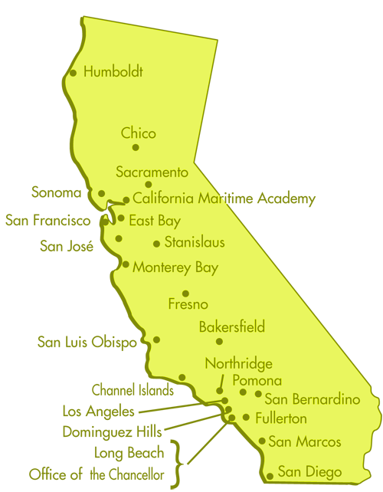

23 CSU
2.0+ GPA
A-G classes
SAT or ACT
Bachelors, Teaching Credential, Masters and some offer PhD/EdD
Getting to College
Dream, Prepare, Go!
Notes:
How many CSU are there?
What does your GPA need to be to get in?
I want to let you know that this number is the least amount you need to get in. Some departments offer much higher and you need to make sure you look into that.
What else do you need to have completed? A-G classes and SAT and/or ACT
What levels of degrees can you get from CSUs?
Personal story: I want to show you guys my first day in Humboldt, when my parents were dropping me off to college. We drove all the way from LA (12 hour drive). I really recommend that whichever college you go to, take a picture with their sign. Because years after you will look back and realize how much you accomplished. You can’t tell in the picture, but I was scared and nervous, it was the first time being on my own, but I was also excited because I picked a place that I felt I can study and grow in. I found comfort in choosing a university that matched my needs.
Ask LEO for more information

Slide 8
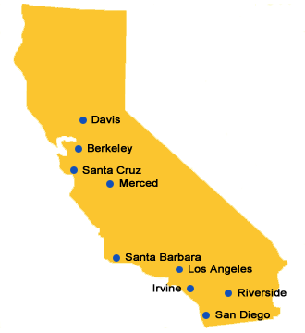
10 UC
3.0+ GPA
A-G classes
SAT or ACT
Bachelors, Masters, Teaching Credentials, and PhD/EdD
Getting to College
Dream, Prepare, Go!
Notes:
How many UCs are there in California?
What does your GPA need to be to get in?
What else do you need to have completed? A-G classes and SAT and/or ACT
What levels of degrees can you get from UCs?

Slide 9
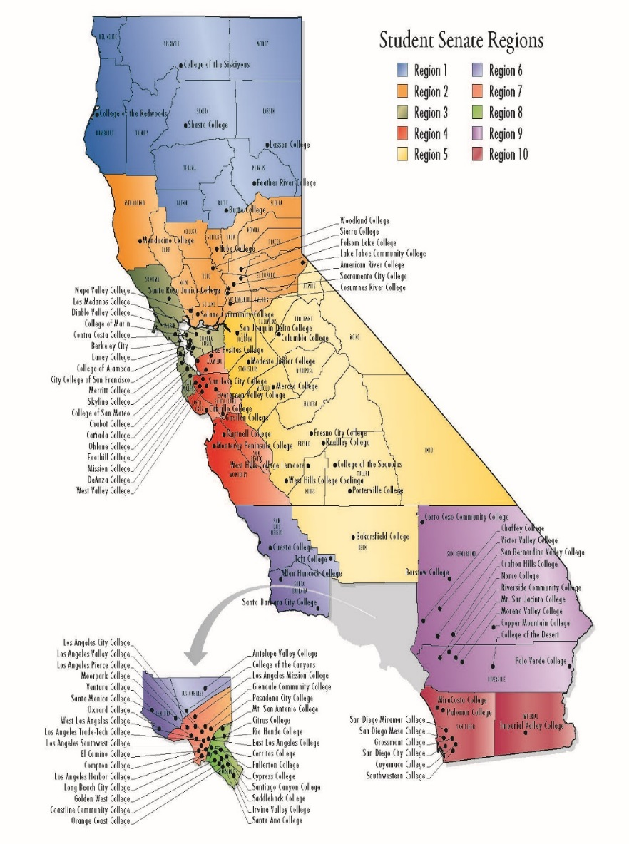
114 CCC
High School diploma
(A-G classes HIGHLY recommended)
Associates Degree and an Associates Transfer
Getting to College
Dream, Prepare, Go!
Notes:
How many Community Colleges are there in California?
What do you need to get in?
I HIGHLY RECOMMEND THAT YOU FINISH YOUR A-G CLASSES BECAUSE IT WILL SAVE TIME AND MONEY. WHEN YOU HAVE TO FINISH YOUR A THROUGH G CLASSES, IT IS DIFFICULT TO STAY MOTIVATED BECAUSE YOU CAN’T BEGIN TO WORK TOWARDS YOUR DEGREE UNTIL YOU FINISH. SO GET IT DONE! In addition of working on your A through G, it gives you room to focus on your careers, what you want to do, you don’t want to be doing high school credit during college. There are many exciting things going on, that shouldn’t be the what holds you back from succeeding. It is a risk that you are taking when you don’t finish your A through G requirements.
What levels of degrees can you get from community college?
What is important to know when choosing a community college? Each one has a specialty.
Personal story: I went to Los Angeles Community College. I transferred from there to HSU. This route worked for me because I wanted to take care of my GE first. I wanted to begin taking the classes that relate more to my career. That is not to say that GE did not help me in my careers, but it was not something I wanted to keep doing. I got out of high school and my community college helped me with finishing the primary classes I needed to finish before moving on to a four year university. This is an option you can take.
Any questions so far?
Prep BEFORE college
Practice your academic now

Slide 10

Getting to College
Dream, Prepare, Go!
Notes:
If you are a tribal member
37 tribal colleges
These colleges focus on tribal culture, community, and language, along with helping you achieve your degree.
They lower the cost of tuition
HSU also offers a strong Native American Program, there are other colleges that help with Native American Studies, Humboldt is a strong one
Any further questions, call them

Slide 11
Prepare
What degrees would set me on my path?
What colleges are a good fit?
What do I need to do to get into my choice colleges?
What college choice is a good investment?
Is working during college a good idea?
Where should I live?
What should I focus on?
Getting to College
Dream, Prepare, Go!
Notes:
How many CSU are there?
What does your GPA need to be to get in?
I want to let you know that this number is the least amount you need to get in. Some departments offer much higher and you need to make sure you look into that.
What else do you need to have completed? A-G classes and SAT and/or ACT
What levels of degrees can you get from CSUs?
Personal story: I want to show you guys my first day in Humboldt, when my parents were dropping me off to college. We drove all the way from LA (12 hour drive). I really recommend that whichever college you go to, take a picture with their sign. Because years after you will look back and realize how much you accomplished. You can’t tell in the picture, but I was scared and nervous, it was the first time being on my own, but I was also excited because I picked a place that I felt I can study and grow in. I found comfort in choosing a university that matched my needs.
Ask LEO for more information

Slide 12


Go!
Getting to College
Dream, Prepare, Go!
Notes:
ADD for sure when the applications open and close
Financial aid (must do) and applications OCTOBER 1,
The boxes helo

Slide 13


Notes:
Big event coming soon?
who has been to the event? How was your experience?
Why is it good to go? How can it benefit you?
You are mentors, influence your nephews and siblings and parents, you are an influencer, you are the future
This is my first time going, it has always landed on a day I have class, but this year I’m ready and I hope to see you there. It is fate.

Slide 14
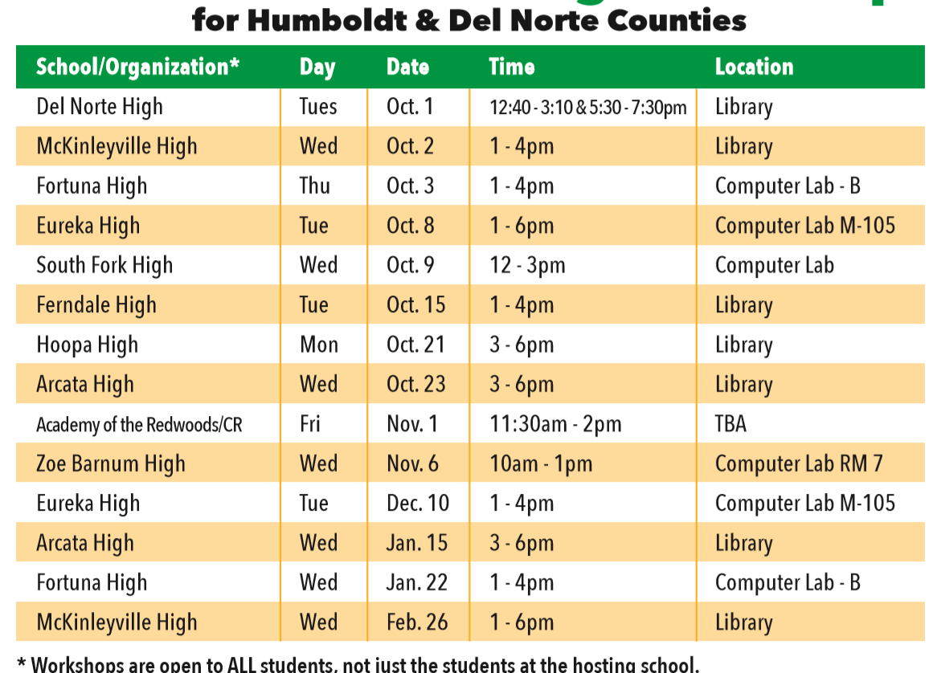

https://www.cash4college.csac.ca.gov/
Getting to College
Dream, Prepare, Go!
Notes:
C4C is coming up, they help you fill out your FASFA! Bring your family, they are not only welcomed but also encouraged.
Take a moment to take a picture of the schedule or write down the website. I really recommend you visit the webpage even though you know the workshop date and location. The website gives you a list of things you need to bring to complete FASFA.

Slide 15


Getting to College
Dream, Prepare, Go!
Notes:
*note to self: grab a new screen shot once it has been updated (coming soon)
This is for students that might not know anyone that is in the major, you can sit and have coffee.

Slide 16

Quick Review/Advice
Resources
Time Management
Be confident in your decisions
Be the College Student
Enjoy Planning
FAFSA
Getting to College
Dream, Prepare, Go!
Notes:
Remember your IKIGAI. I was a person that didn’t find it until I was in college, but I strongly believe that being in college helped me find it sooner. I was studying to be a civil engineer. I enjoyed math, but not as much as reading. Enter Personal story mode (about being lost in community college and than knowing literature was my thing)
Resources: Take advantage of the resources around you. I suggest to have a personal folder that has your flyers, brochure, documents, and your notes that contains links, places you to go to when you need a specific answer. It is important at this time to keep your documents organize. And to take notes of every meeting, website you go to and you find something interesting. So when it is time for you to sit down you can look at what all the knowledge you ‘ve gathered and make the best choice for yourself.
Time Management is an extremely important skill to have. You know yourself more than anyone. (You know what time of the day your most productive, if you are a visual, hearing, doing learner, or a combination of the three.) I say this because this plays a key role in picking what time you want your classes, in organizing and planning what you need to have done before applying. One thing is for sure, you risk a lot if you leave it to the last minute.
Be confident: This is your future you are planning your life, nobody else. You are the one who is going to be attending the school, learning, and getting through the obstacles.
Be the Student. You should practice being the college student right now. Don’t wait until you are there. You are independent learners, meaning that if you don’t know something you don’t wait until someone else teached it to you, you go and find those answers. That means when you are struggling in a subject you look for tutoring, when you are struggling in a class you look for office hours, and a really important one is when you feel that you need self care, you reach out. Because life is messy and unpredictable, it important to take care of yourself.

Slide 17
Supporting Youth to
DREAM, PREPARE, GO!
Jana Ashbrook
Academic Preparation for College
eap@ humboldt.edu
Gettingtocollege.Humboldt.edu
Getting to College
Dream, Prepare, Go!
Notes:
No matter what pathway you take, consider your year a bridge year.

Slide 18
Admissions gets you into college
Placement will impact what GE classes you will take and if you will take extra support classes.
College
Admissions
(College Eligible)
vs.
College
Placement
GE - General Education is the required curriculum that makes up the foundation of an undergraduate degree.
Getting to College
Dream, Prepare, Go!
Notes:
Vocab moment! Difference between the two
+add what GE is, own experience and why it is important.

Slide 19

Getting to College
Dream, Prepare, Go!
Notes:
The language students will be hearing from
PASS OUT Booklets

Slide 20

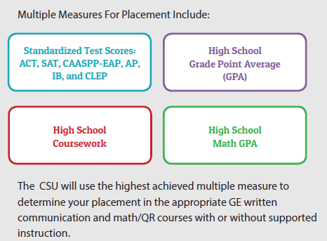
Getting to College
Dream, Prepare, Go!

Slide 21

Getting to College
Dream, Prepare, Go!
Notes:
Let students open the book and ask them “check the box that they think they would have completed by the end of their senior year”
The pairing of the boxes

Slide 22

Getting to College
Dream, Prepare, Go!
Notes:
There are two different charts for math.
The concept of STEM and non-STEm > math intensive and non-intensive.
Give example of majors and point out that some will be math intensive

Slide 23

Getting to College
Dream, Prepare, Go!

Slide 24

Register for ACT
Explore english and math interactive tools
Register for SAT
Getting to College
Dream, Prepare, Go!
Notes:
Take the for sure CSU success web page for more
If you didn’t like the list you can use the estimator to help
Only contact the list if they have questions about their placement (ONLY)
Who to call with what type of question (give examples)

Slide 25
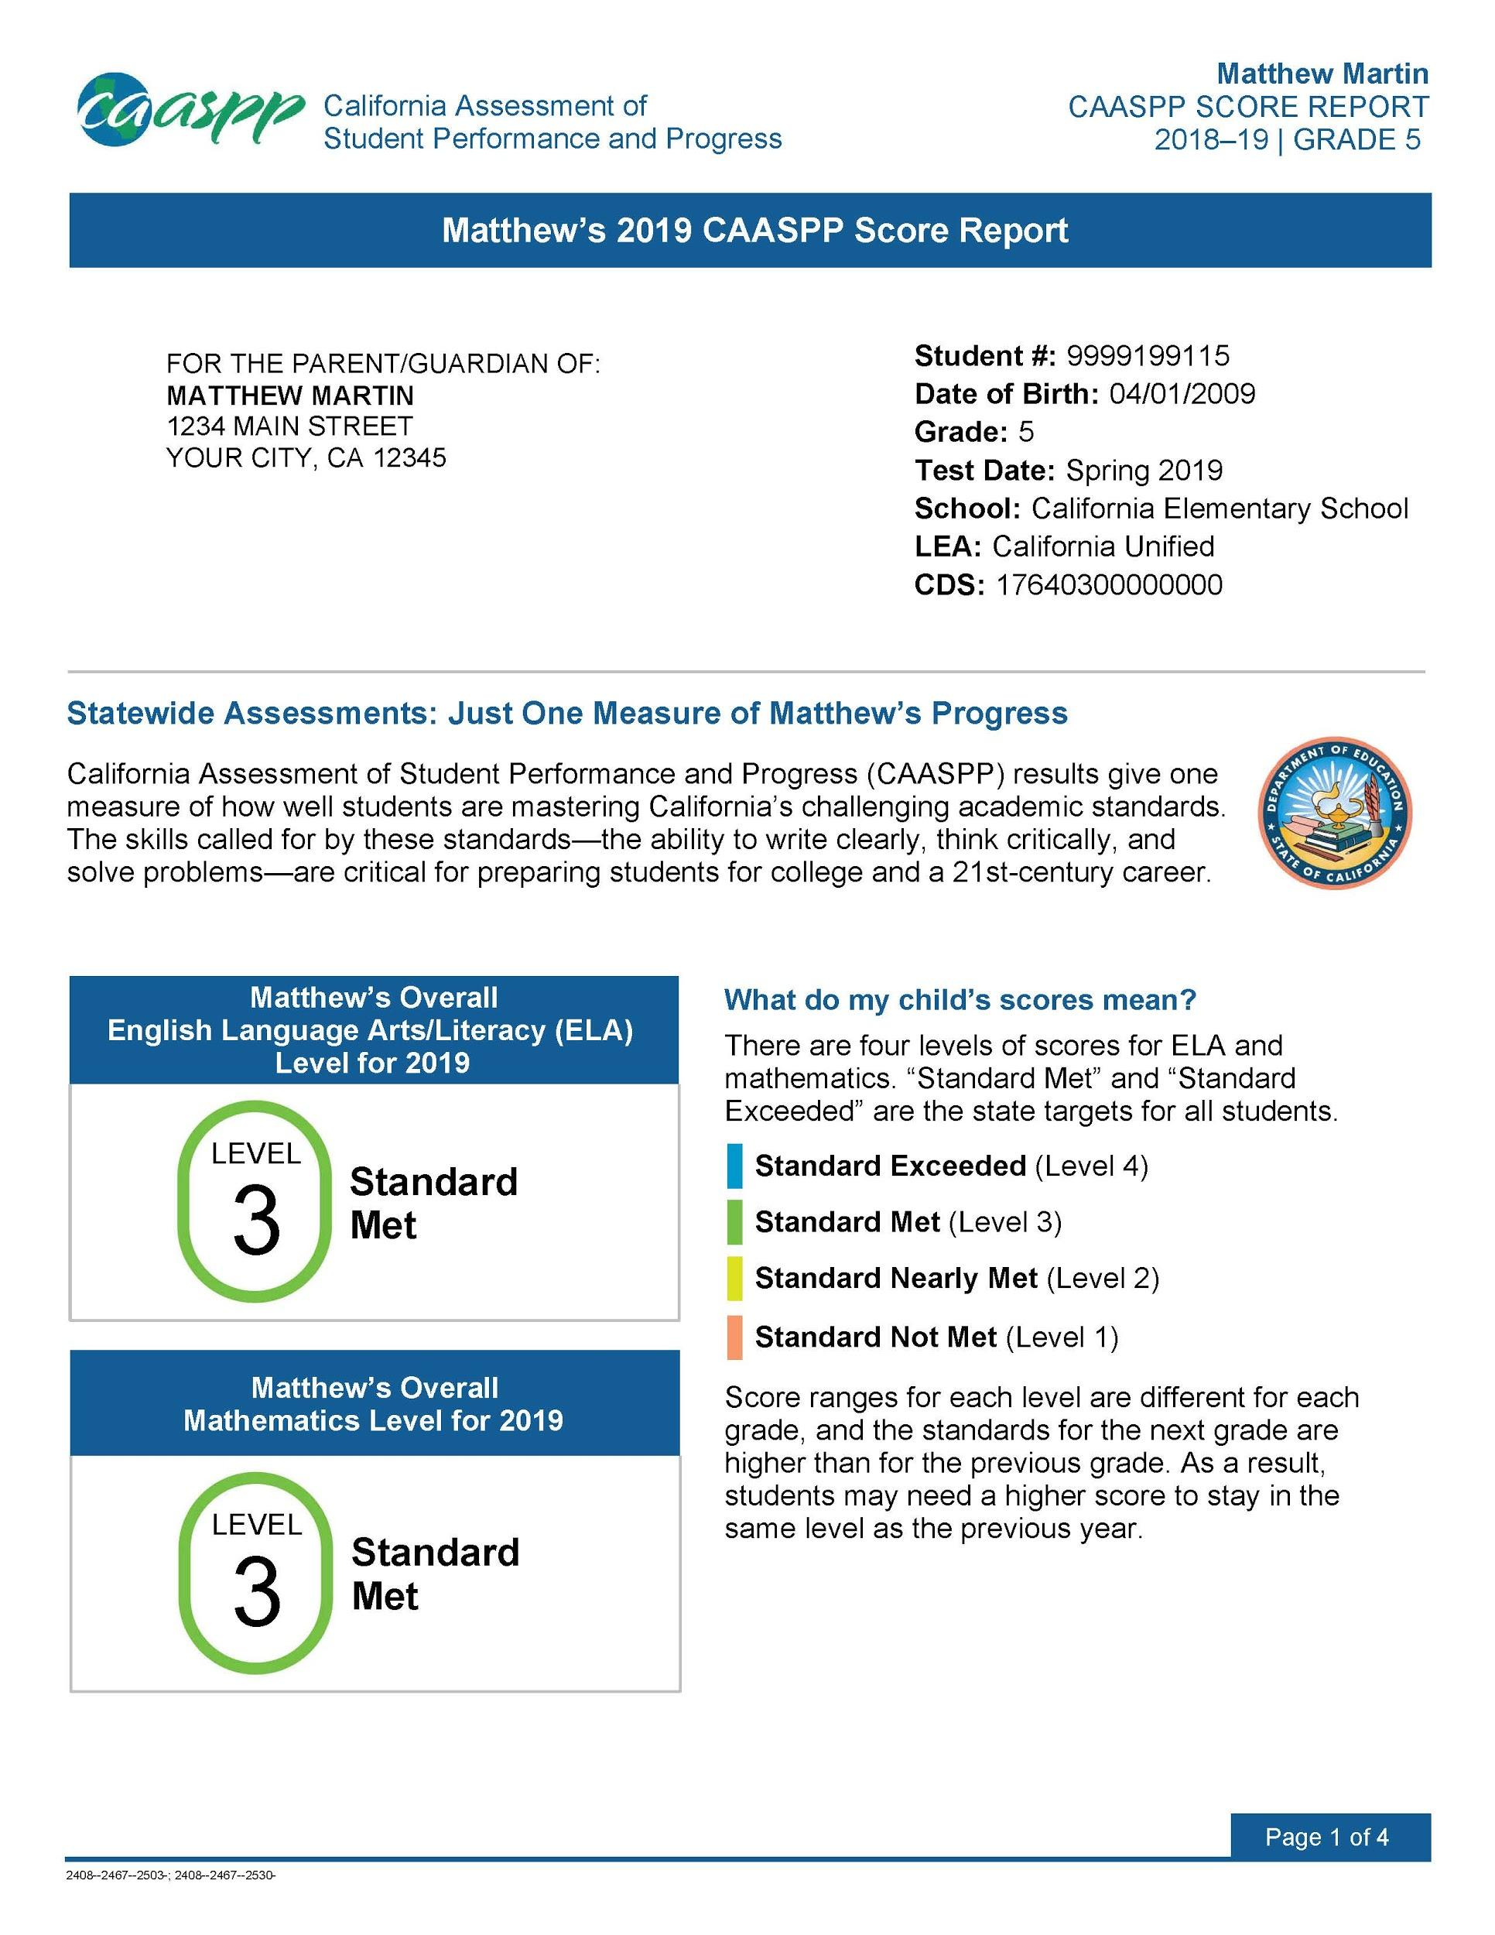
Getting to College
Dream, Prepare, Go!
Notes:
Find the score in student portal
Very brief and “talk to your counselor if you can’t find it”

