Slide 1
OVERVIEW
California State University and UC Systems
(UC’s and CSU’s)
Trivia: The first CSU was built in 1857 in San Jose.
GO SPARTANS!

Slide 2
Overview of CSU’s and UC
What are the UC/CSU Systems?
What are the similarities?
What are the differences?
What can I do now to be eligible?
What are the application deadlines?
What does it cost?
What does “impaction” mean?
What resources are out there?
What questions do you have?

Slide 3


Similarities (UC and CSU)
Public Institutions
A – G Rigorous Curriculum
  GPA after 9th Grade
  Use eligibility Index
ACT or SAT exams
Offers Bachelors, Masters, and Professional Degrees
Have impacted/closed majors at some campuses
Only have to fill out one application fro all 23 CSU’s or 10 UC’s. (Fee’s apply to each)

Slide 4
Differences
The Application Process
The Cost of Attendance
Holistic Review (UC)
The Eligibility Index
  GPA
  ACT and SAT Writing

Slide 5
Knowing the A-G’s
To be eligible for UC’s and CSU’s you NEED these classes
Letter | Area | Years Required | Years Recommended
A | History/Social Sciences | 2 years
B | English | 4 years
C | Mathematics | 3 years | 4 years
D | Laboratory Sciences | 2 years | 3 years
E | Language Other Than English | 2 years | 3 years
F | Visual and Performing Arts | 1 year
G | College-Preparatory Electives | 1 year

Slide 6
Knowing the test requirement
SAT OR ACT???
ACT TEST
  www.actstudent.org
  ACT Essay: Optional
  (always recommended)
SAT TEST
  www.collegeboard.org
  SAT Essay: Optional
  (always recommended)

Slide 7
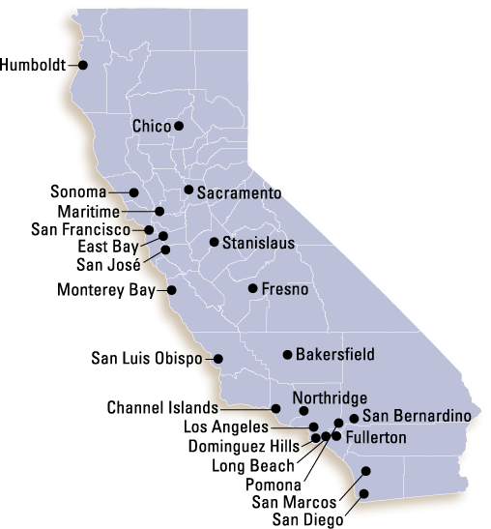
California Sate University (23 campuses)

Slide 8

Average Cost of Attendance
On Campus:
  $25, 000 (ish)
Off Campus
  $23,000 (ish)
With Parents
  $16,000 (ish)
  Tuition: $7,000 (ish)

Slide 9

CSU Application Process
calstateapply.edu
Oct. 1st – Nov. 30th
Take ACT/SAT by
December of your
Senior year

Slide 10
Eligibility Criteria for CSU’s
Eligibility Index
A – G coursework (15 units)
Grades in A – G courses
(C’s or better)
ACT or SAT test scores
High School Graduation
3.0 GPA qualifies with any ACT/SAT test score
Impacted majors may exist on some campuses

Slide 11
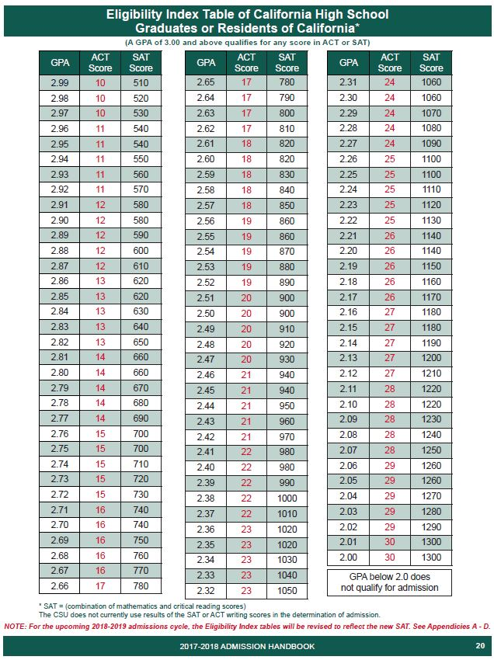

Slide 12
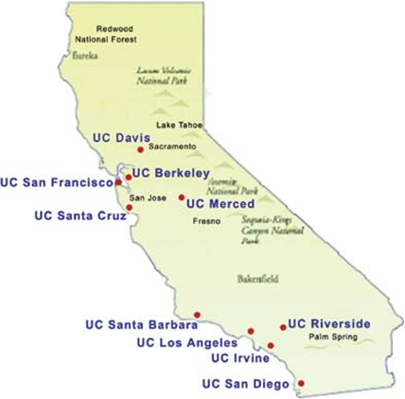
University of California (10 campuses)

Slide 13
Average Cost of Attendance
On Campus:
  $32,400 (ish)
Off Campus
  $29,200 (ish)
  TUITION: $14,000

Slide 14
UC Application Process
www.universityofcalifornia.edu
Aug. 1st (prep period)
Nov. 1 – 30th (filing period)
Take ACT plus writing or the SAT by December of your senior year
Compose Personal Insights

Slide 15
Personal Insight questions
You will have 8 questions to choose from. You must respond to only 4 of the 8 question
Each response is limited to a maximum of 350 words.
Which questions you choose to answer is entirely up to you: But you should select questions that are most relevant to your experience and that best reflect your individual circumstances

Slide 16
3 examples (out of 8)
Describe an example of your leadership experience in which you have positively influenced others, helped resolve disputes or contributed to group efforts over time.
Describe how you have taken advantage of a significant educational opportunity or worked to overcome an educational barrier you have faced.
What have you done to make your school or your community a better place?

Slide 17
Eligibility Criteria for UC’s
Eligibility Index
A – G coursework (15 units total)
11 of them complete before the 12th grade.
ACT plus Writing or
SAT test scores
High School Graduation
3.0 minimum weighted GPA
Impacted campuses/majors may require SAT Subject tests
Top 9% in your class = guaranteed admission (UC’s overall)
Holistic Review

Slide 18
HOLISTIC REVIEW 14 Factors
Beyond grades and test scores
Academic GPA
Test Scores
Courses beyond A – G
Honors/AP/IBO
Senior year courses
Outstanding in a subject
Doing all you can with what is offered
Outstanding projects
Marked academic improvement
Special talents/achievements
Special Projects tied w/ curriculum
Accomplishments in light of tougher circumstances
Location of your school/home
Rank in top 9 % of your class

Slide 19
Impaction.
Impaction means that a campus receives more eligible applicants then they can accommodate and therefore must restrict enrollment to that campus (often requiring higher eligibility standards.
  Impacted Campuses
  Impacted Majors and Programs
  Impacted Groups: (Freshman, Transfers)

Slide 20
List of Resources
www.actstudent.org (ACT)
www.collegeboard.org (SAT)
www.assist.org (A – G)
www.calstateapply.edu (Apply)
www.universityofcalifornia.edu
(Apply)
www.fafsa.gov (Free Money)

Slide 21
Ask Yourself
Am I on the A – G college prep track?
Whose responsibility is it to make sure I am?
What if I have a “D” grade on my transcript in an A – G course?
Who can I go to for guidance and assistance?

Slide 22
WHERE CAN YOU GO?
  High School Counselor
  AVID/TRiO/CalSOAP
  High School Teachers
  The colleges in your area
  The internet
  Me! (Jen) 707 826-3558
  AND……..

Slide 23
ONE MORE SUPER COOL WEBSITE!!!
www.californiacolleges.edu
  Career Planning
    Explore Careers and Job Outlooks
  High School Planning
    Planning timeline, How to succeed in High School
  College Planning
    Explore Schools, Programs, Majors, and test prep
  Financial Aid Planning
    Scholarships, Grants, etc…
  Your Portfolio
    Tools and Resources appropriate to YOU.

Slide 24
Questions?
TRiO Upward Bound
Jen Dyke jen.dyke@Humboldt.edu
Northcoast Cal-SOAP
(707) 441-2006

