Slide 1

Placement for Seniors
CSU updates
Jana Ashbrook
CSU Early Assessment Program Coordinator
jana@humboldt.edu
earlyoutreachprograms.humboldt.edu

Slide 2






College Pathways

Slide 3








Slide 4
Admissions
(College Eligible)
vs.
Placement
(College Ready)
Admissions gets you into college
Placement will impact what classes you can take, if you have to take extra support classes, and if you have to take Early Start

Slide 5
Your Opportunities
For Placement

Slide 6
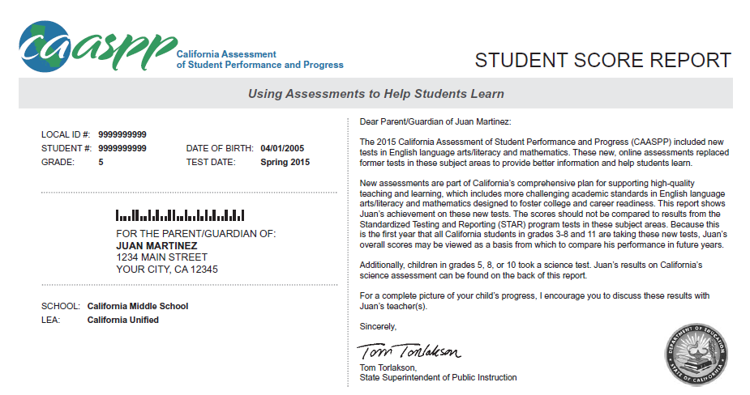

Slide 7
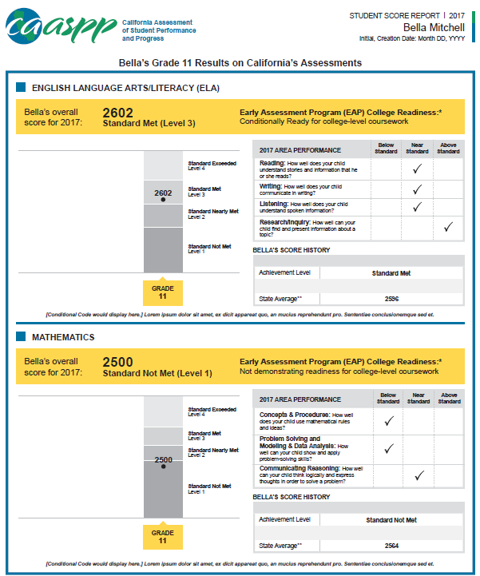

Slide 8
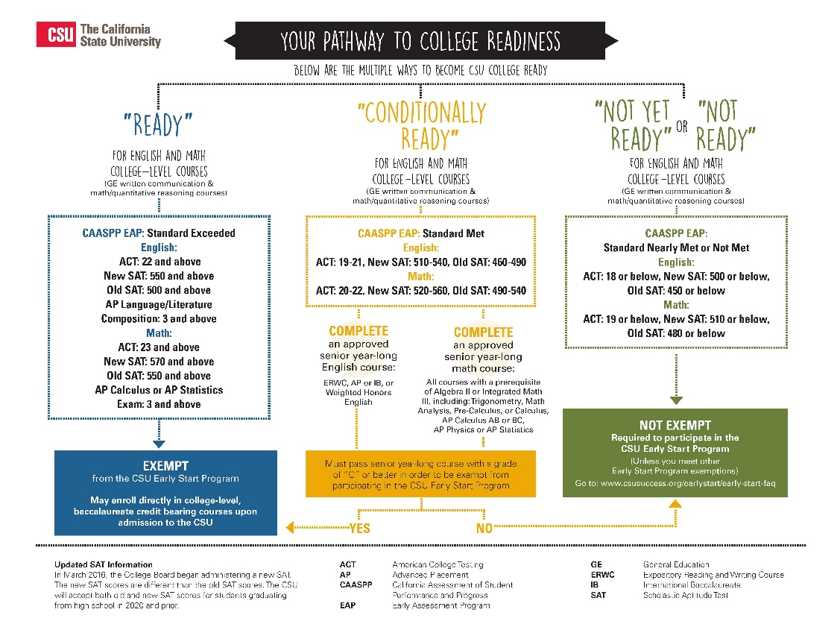

Slide 9
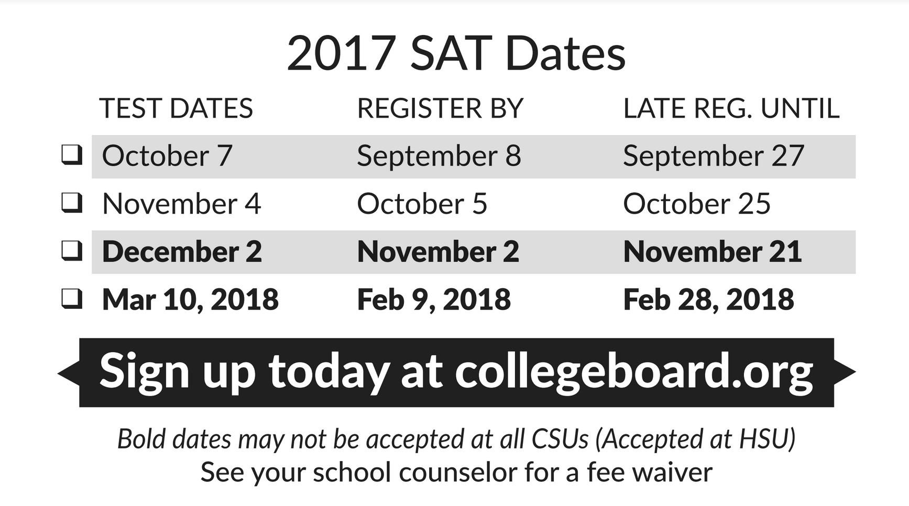
Don’t Procrastinate
Notes:
Don’t panic, there are still options for seniors.
and there will an appeals process.
Do your best,
The skills are the thing that actually make you successful.
Now iis not the time to procrastinate

Slide 10
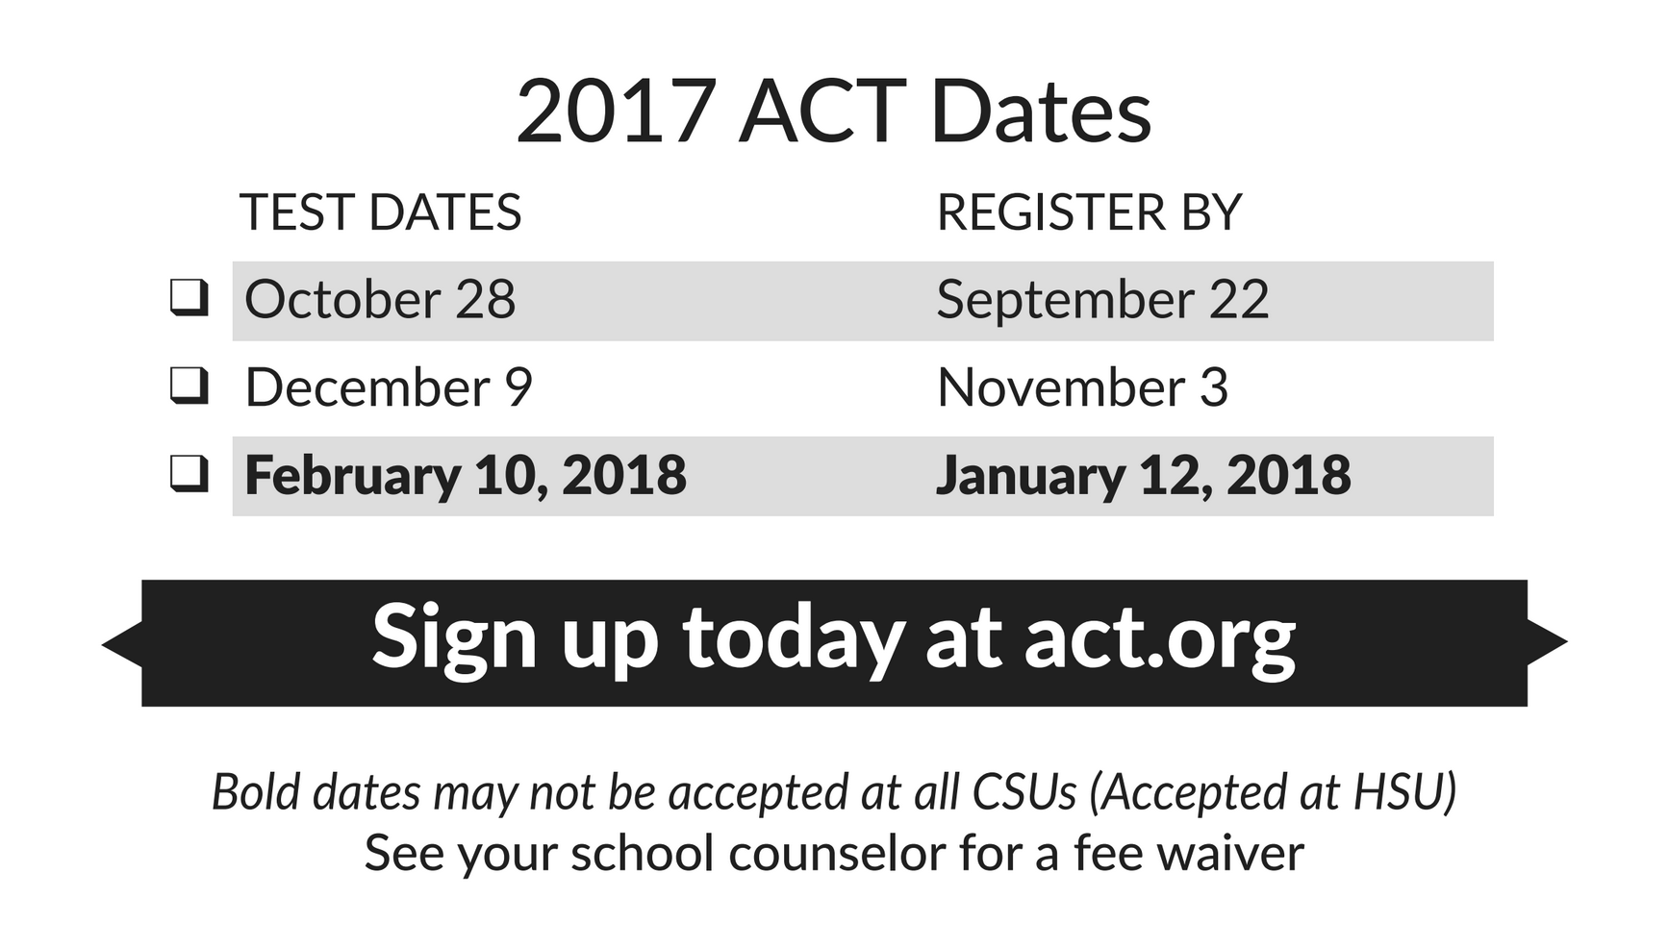

Slide 11
CAASPP scores are not accepted for admissions, only placement
Some students may not need SAT/ACT scores for admissions, but will want them for placement
If you are on the cusp of not needing SAT/ACT scores for admissions (example: 3.01 GPA), consider getting scores anyways.
scores do not count against you for admissions
Special
Notes

Slide 12
Placement…
into
what classes?
Early Start
English & Math Support Classes
College Level English & Math Classes

Slide 13
Fall
FAFSA – Oct. 1 (Funds are competitive, apply early!)
California State University Applications – Oct. 1
University of California Applications – Nov. 1
Spring
Compare Financial Aid Award Letters
(when possible)
Decision Deadlines are often May 1
(check w. campus, often include an enrollment deposit)
Housing Applications are usually due in Spring
Sign up for Orientation – Show up for Orientation!
Transition to College!

Slide 14
Resources for You
EarlyOutreachPrograms.Humboldt.edu

Slide 15

Jana Ashbrook
CSU Early Assessment
Program Coordinator
Jana@ humboldt.edu
EarlyOutreachPrograms.Humboldt.edu
Thank you!

Slide 17
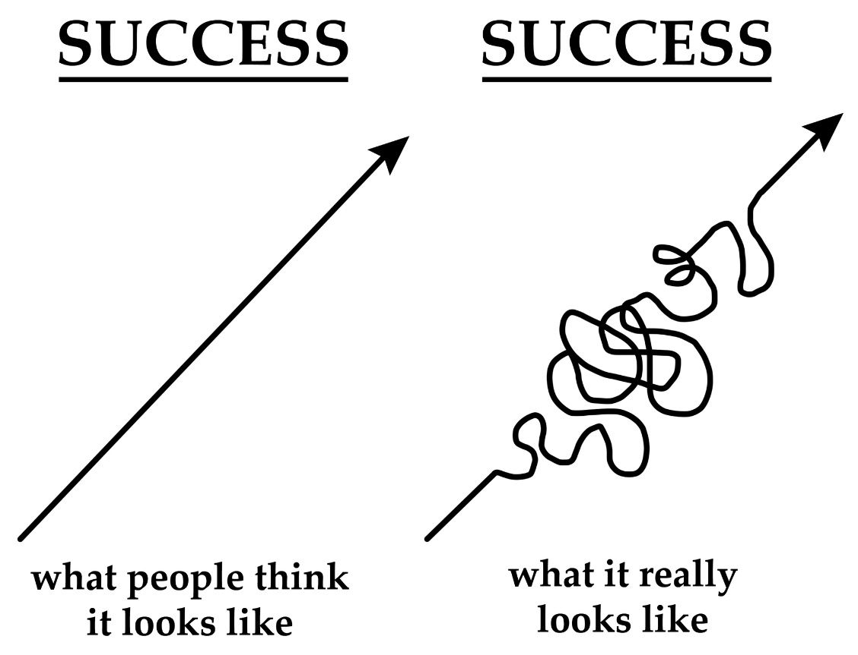

Slide 18

I am pursuing/exploring what I love by…….
I am strengthening what I am good at by……
I want to contribute to the world by…..

Slide 19
Advice
for
Seniors

