Slide 1

Study Strategies for the SAT: Critical Reading, Writing & Language, and Math
Notes:
Introduce yourself, and a bit of your applicable background: Experience as an SAT/ACT tutor, Writing Tutor, some of your education, and the like: maybe 2-3 minutes.

Slide 2
Objectives:
Review some sample questions and strategies for the Reading Test, Writing & Language Test, and Math Test
Introduce students to Khan Academy + CollegeBoard’s study portal

Slide 3
Writing & Language Section
In this section, you’ll be expected to identify grammatical errors in sentences and how to correct them.
Common types of errors you’ll encounter:
  Incorrect Spelling
  Incorrect Punctuation
  Sentence Combining
  Subject- Verb Agreement
Notes:
How many people have been told they use run-ons? Comma splices? Or consider themselves bad spellers? I’m here to provide some quick tips from my experience in how identify and fix errors without having to know every grammar rule.

Slide 4
Correct Spelling
Commonly misspelled words are regularly featured on the test, and these are probably the easiest points to score on your test. Very often these are words that sound the same, but have different meanings. Be careful to slow down and pay attention since these are also easy to gloss over.
Here are some examples:
    There/They’re/Their
    Accept/Except
    Effect/ Affect
    Were/Where/We’re
    For a good starting place on commonly confused words, check out http://homepage.smc.edu/reading_lab/words_commonly_confused.htm
    TIP: Identifying the part of speech can be a big help, even if you don’t know the word’s meaning.
Notes:
Get a volunteer to provide a correct usage of one of the sets of commonly confused words.
What are some other words you commonly confuse?

Slide 5

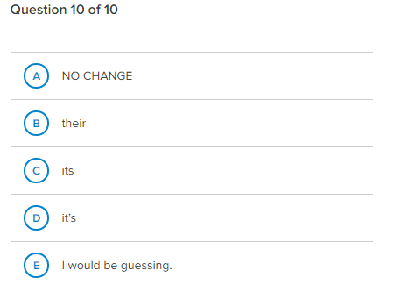
Example provided is taken from the Khan Academy Writing & Language Diagnostic Quiz

Slide 6
What are commas used for ?
You’ll be expected to know how to use commas and semi-colons correctly. It isn’t enough to know if a sentence is correct or incorrect, you’ll also be expected to know how to fix it.
Here are some common uses for commas:
  To separate dependent and independent clauses
    Although no witnesses have come forward, the investigators are confident they will solve the case.
    If your subordinating conjunction is in the middle of a sentence, no comma is needed
      The investigators are confident they will solve the case although no witnesses have come forward.
  To link two complete sentences together using a coordinating conjunction (a.k.a = FANBOYS)
    Scientists are often expected to reproduce their results from experiments, ___ it is not uncommon for scientists doing similar research to share their procedures with one another.
  To provide extra information, often about the subject
    Humboldt State University, the northernmost CSU in California, is more than 100 years old.
    The northernmost CSU in California, Humboldt State University is more than 100 years old.
  TIP: Whenever you have a subordinating conjunction at the start of a sentence, you have a dependent clause.
    (see http://www.chompchomp.com/terms/subordinateconjunction.htm for more info)
Notes:
Who can describe what an independent and independent clause are?
-Remember Independent means it can stand on its own, Dependent means it needs some help.
Anyone know what the FANBOYS stand for?
For= because
And= continuation, agreement
Nor= commonly used with neither (neither/nor)
Or= exclusivity → This OR that, (Either/Or)
Yet= Despite
So= as a result of something else

Slide 7
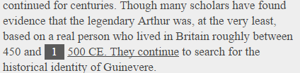
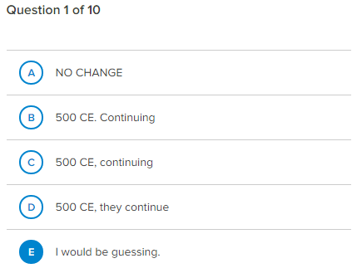
Example provided is taken from the Khan Academy Writing & Language Diagnostic Quiz
Notes:
Let’s take a look at this example. Let’s read the sentence first and understand what, if anything, is wrong with it before we look at the answers.

Slide 8
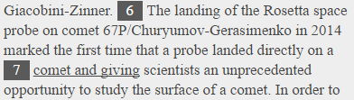
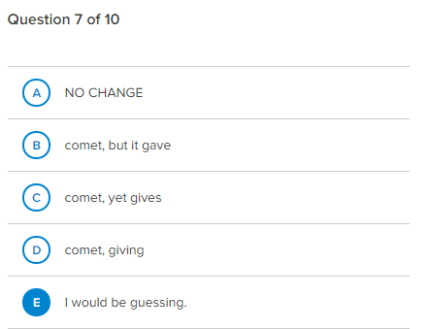
Example provided is taken from the Khan Academy Writing & Language Diagnostic Quiz
Notes:
Now this one is different than the last one, but it you look back at slide 6 at the bottom, there’s useful info for figuring this one out.

Slide 9
The Reading Section
The SAT features 5 reading passages, which may include a single long passage or 2 shorter passages. There are several common types of questions that are featured in the SAT Reading Section. For this session, we will be focusing on:
  Vocabulary in Context
  Main Idea/ Point of View
  Making Inferences
Notes:
There is also a “finding the facts” type question, and for these, the answer to the question is in the text of the reading.

Slide 10
Vocabulary in Context
How to recognize these questions:
Short, clear and direct.
Make a specific line reference.
Ask for a closest synonym (most often).
What makes these tricky?
  Often test words that have multiple meanings
  Require students to understand HOW a word is being used
  Tests secondary meanings of words.
TIP: Make sure you are using a well established dictionary that provides word roots, endings, and multiple meanings. Try https://ahdictionary.com, http://www.merriam-webster.com/, http://www.ldoceonline.com/

Slide 11

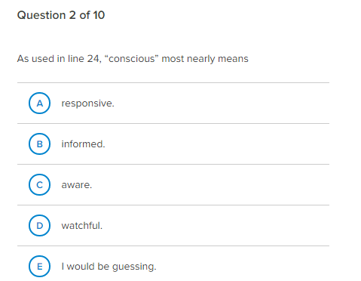
Example provided is taken from the Khan Academy Reading Diagnostic Quiz
Notes:
In a vocabulary in context question, what should you do first?
How many think you read the passage first?
How many think you should read the question first?
For these specific type of questions, go straight to the question first, it will tell you exactly where to look for your answer. DO NOT LOOK AT THE ANSWERS FIRST!!! I’m going to introduce you to a strategy called: Read Predict Apply. First read the question, next read the sentence, then make a prediction about what the word means. Compare what you predicted to the answer choices and choose the one that best matches your prediction.

Slide 12

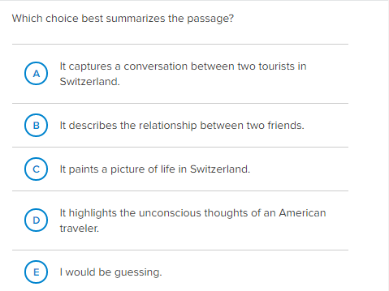
Main Idea/ Point of View
How do I know if a question is asking about the main idea? Look for these key words:
Author’s message
Main Idea
Main point
Primary purpose
Summarizes
Example provided is taken from the Khan Academy Reading Diagnostic Quiz
Notes:
For Main Idea, you’ll want to look at the end of the intro or conclusion paragraphs

Slide 13
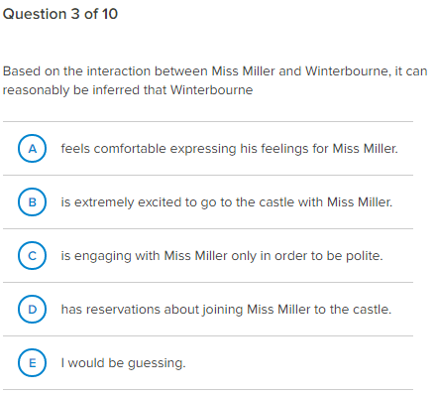
Making Inferences
Inference questions ask you to make reasonable assumptions about what might be true based on evidence and details provided in the text.
May often use some form of these words:
Infer
Gather
Conclude
Assume
TIP: If you’ve identified a question as an inference type, you can eliminate answers that are explicitly stated in the text
Example provided is taken from the Khan Academy Reading Diagnostic Quiz

Slide 14
More Math Tips
Tip #2: Use every tool you can to solve a problem. This might require guesstimating, substitution, and process of elimination.
Decode:
  “each” means multiply (x)
  “and” means +
  “revenue was” means =
Rewrite:
  6.5 (S) + 2 (D)= $836.50
Estimate the number of salads. I recommend an easy number like 100.
  100. 6.5(100) + 2(100) = $850 → too much.
Eliminate: If you know that 100 salads was just a bit too much, which answer makes the most sense?
Check: Substitute your answer into your rewritten equation
6.5(93) + 2(116) = $836.50
A food truck sells salads for $6.50 each and drinks for $2.00 each. The food truck’s revenue from selling a total of 209 salads and drinks in one day was $836.50. How many salads were sold that day?
77
93
99
105
Excerpt from Practice Test 1.- pg49. Available at https://collegereadiness.collegeboard.org/sat/practice/full-length-practice-tests

Slide 15
Math Tips
Tip #1 : Know what you are getting yourself into. Before you begin any problem, always ask yourself 3 questions:
  What is the question asking me to solve for?
  What information do I need to know to solve this problem?
  Do I have enough information/skills to solve this problem?
Example:
Steps to solve:
Decode:
  “is” translates to =
  “more than” translates to +
Rewrite the problem
  16+4x= 10+14
Solve for X
  16 + 4x = 24
  4x= 8
  X=2
Am I done?
If 16 + 4x is 10 more than 14, what is the value of 8x?
2
6
16
80
Excerpt from Practice Test 1.- pg43. Available at https://collegereadiness.collegeboard.org/sat/practice/full-length-practice-tests

Slide 16
Thank You !!!
Comments, Questions, Suggestions?
Elva Ortega
Educational Talent Search Advisor
for Arcata & Eureka High School
Tutor Coordinator
Office: 707-826-5214
Email:
elva.ortega@humboldt.edu
emo25@humboldt.edu

