Slide 1

Understanding the SAT & ACT

Slide 2
Objectives
Identifying what the SAT/ ACT are
Understanding the differences between the tests
Assessing which test should be taken

Slide 3

What are the SAT and ACT ???
Standardized tests used in the admissions process by public and private universities.
A factor used by universities to award merit-based scholarships.

Slide 4
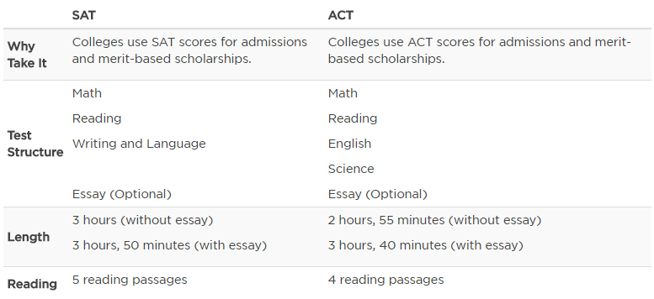
SAT and ACT: What’s the difference?
http://www.princetonreview.com/college/sat-act

Slide 5
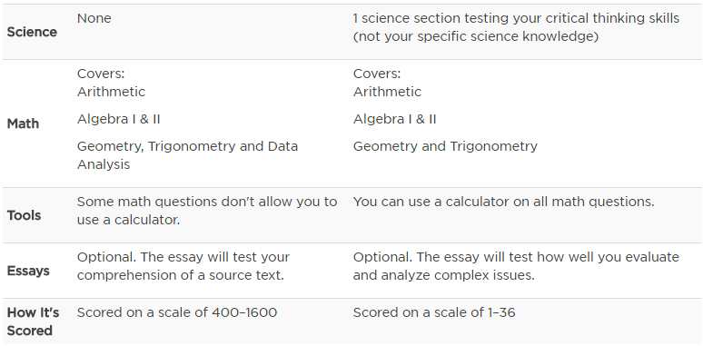
SAT and ACT: What’s the difference?
http://www.princetonreview.com/college/sat-act
Notes:
In my experience, the ACT will test higher math with more frequency, but will not require data interpretation and graphical analysis.

Slide 6
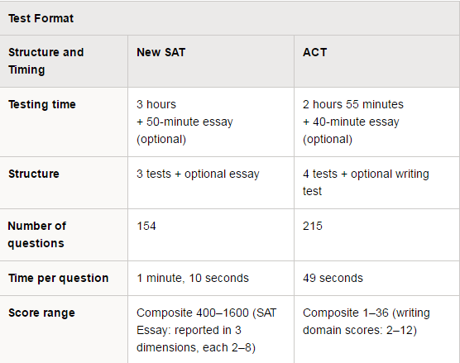
So which one should be taken? Influencing Factors
https://collegereadiness.collegeboard.org/sat/inside-the-test/compare-new-sat-act
Notes:
In my experience, one of the key difference between the two tests is the number of questions. More questions means less time per question, but just because the SAT has fewer questions, doesn’t make it easier. SAT reading questions are not as straightforward as the ACT questions and can take more time to understand what’s being asked than it does to find the answer to the question.

Slide 7
Comparing Side by Side
ACT: Total (w/o Essay) | SAT: Total (w/o Essay)
English 75 questions 45 minutes 36 sec/question | Writing & Language 44 questions 35 minutes 47 sec/question
Reading 40 questions 35 minutes 52.5 sec/question | Critical Reading 52 questions 65 minutes 75 sec/question
Math 60 questions 60 minutes 1 minute question | Math 58 questions 80 minutes 1 minute and 20 sec/question
Science 40 questions 35 minutes 52.5 sec/question
Essay (optional) – 50 minutes | Essay (Optional) – 40 minutes

Slide 8
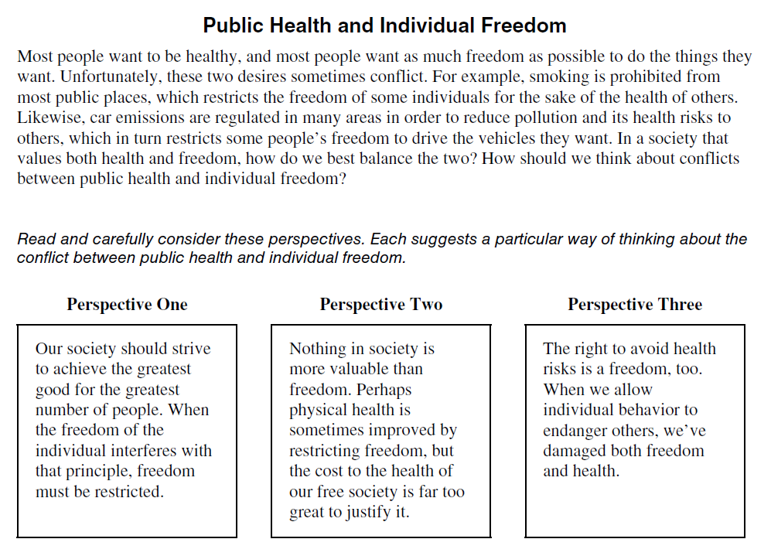
The Essays
ACT
The ACT essay is a persuasive essay. It will offer several positions/points of view on a controversial topic. Students are required to choose a position and providence evidence in support of their position.
http://www.act.org/content/act/en/products-and-services.html

Slide 9
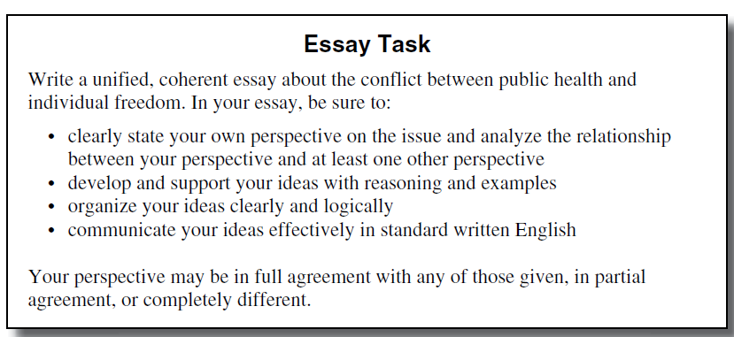
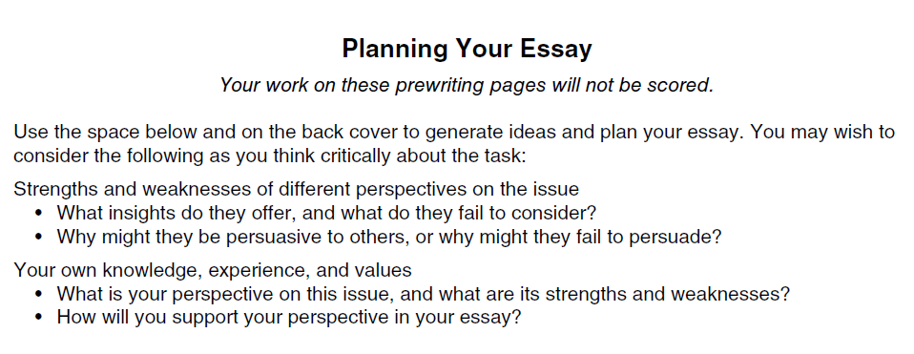
The Essay
ACT

Slide 10
The Essay- SAT
The SAT essay will require students to read and analyze a short passage.
This essay will require students to evaluate the effectiveness of the author.
  How does the author present their main argument?
  What rhetorical devices does the author use to make their point?
  What kinds of evidence does the author include to demonstrate their point?
  How effective/successful is the author in making their point?
NOTE: Students are not required to take a position.
SAT Practice Test Essays

Slide 11
Useful links for understanding the tests
https://collegereadiness.collegeboard.org/sat/practice
https://collegereadiness.collegeboard.org/sat/inside-the-test/compare-old-new-specifications
https://collegereadiness.collegeboard.org/sat/inside-the-test/compare-new-sat-act
http://www.act.org/content/act/en/products-and-services/the-act/test-preparation.html
http://blog.prepscholar.com/complete-official-act-practice-tests-free-links
http://www.princetonreview.com/college/act-test-prep
https://www.kaptest.com/sat
https://www.kaptest.com/act

Slide 12
Thank You!
Elva Ortega
Educational Talent Search Advisor
for Arcata & Eureka High School
Tutor Coordinator
Office: 707-826-5214
Email:
elva.ortega@humboldt.edu
emo25@humboldt.edu

